Slide 2
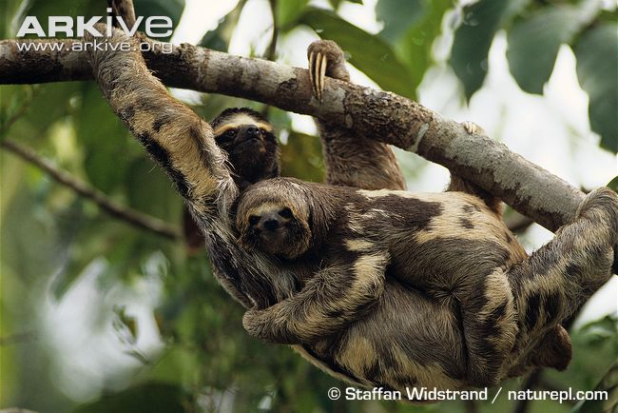
What is EVOLUTION?
Vimeo evolution videos
What do you already know?

Slide 3
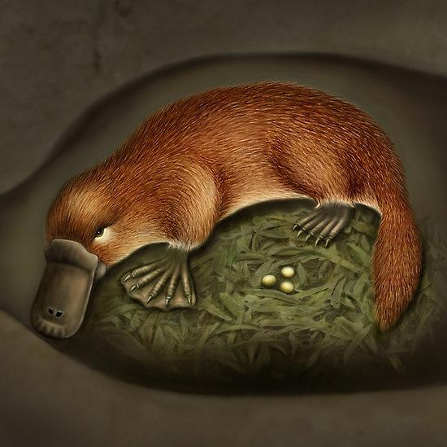
What questions do you have about evolution?

Slide 4
Questions that needed answered
Why do so many different animals have the same structures, the arm bones in a human are the same bones as a flipper in a whale?
Why is the sequence of DNA very similar in some groups of organisms but not in others?
Why do the embryos of animals look very similar at an early stage?

Slide 5
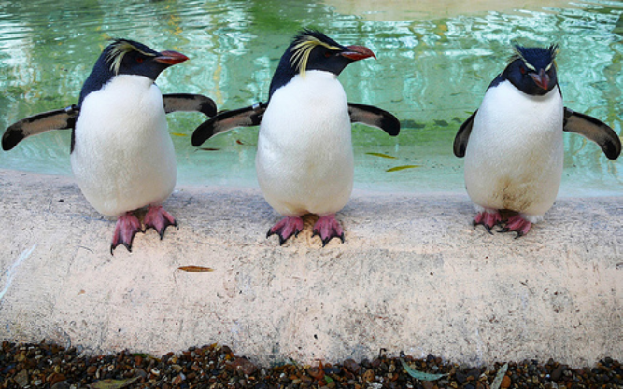
Photo courtesy of Swamibu, Flickr Creative Commons

Slide 6
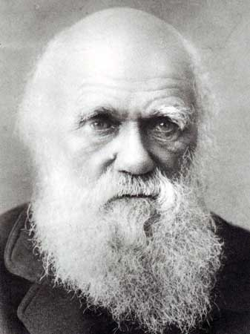
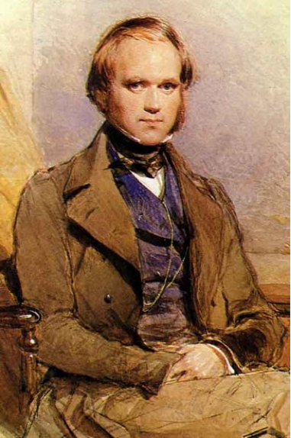
Charles Darwin developed the Theory of Evolution by NATURAL SELECTION
... which explained how organisms changed over time (ADAPTED)

Slide 7
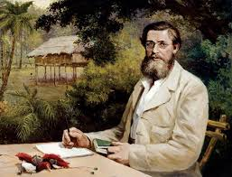
Alfred Russel Wallace, speculating on evolution by natural selection, based on his studies of the distribution of plants and animals. He prompted Darwin to publish his findings On The Origin of Species.

Slide 8
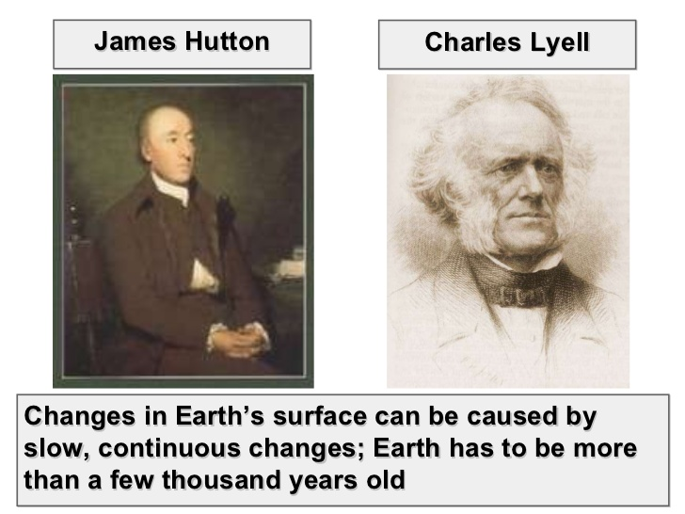
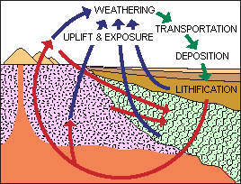
Ideas that Helped Shape Darwin’s Thinking
Geologists Hutton and Lyell - concluded that processes that shaped the earth in the past are the same as those at work in the present. Also, the earth would have to be old enough for these processes to occur over a very long time. This is called uniformitarianism.

Slide 9
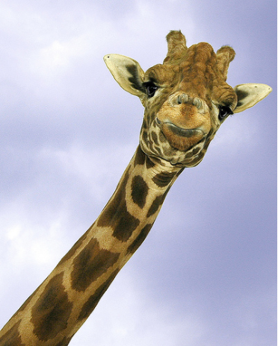
Ideas that Helped Shape Darwin’s Thinking
Lamark's Theory of Acquired Characteristics
Thought that you would gain traits if you used them OR lose them if you didn't use them (use/ disuse)
!! INCORRECT !!
Photo courtesy of ucumari, creative commons, flickr

Slide 10
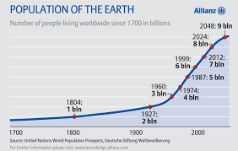
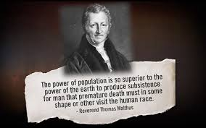
Ideas that Helped to Shape Darwin’s Thinking
Malthus - said that if the human population grew unchecked there would not be enough resources to support everyone

Slide 11
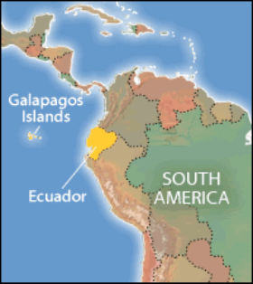
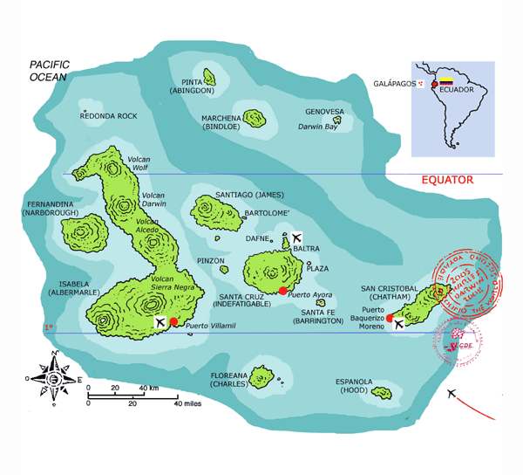
Darwin was a naturalist (what we today call biologists)
He traveled the world and made observations and sketches
Aboard the H.M.S. Beagle, he traveled to the Galapagos Islands

Slide 12
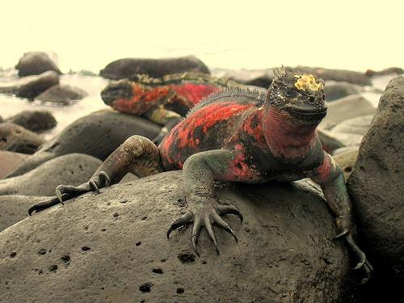
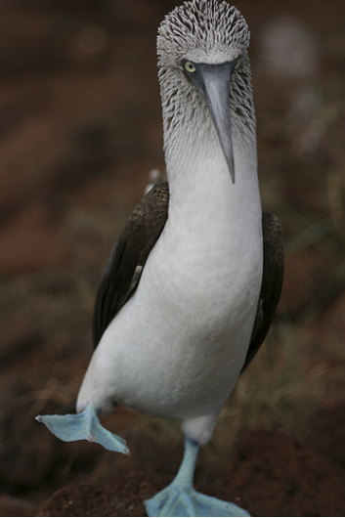
Marine Iguana
Blue-footed booby

Slide 13
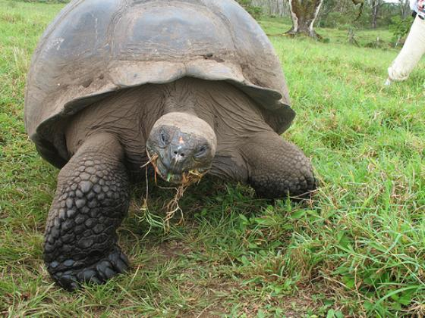
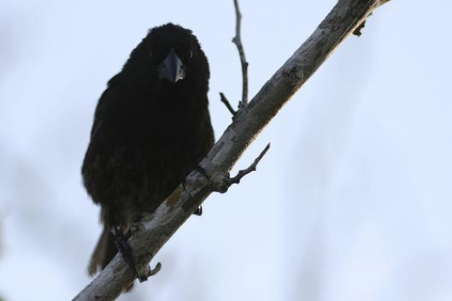
Finch
Giant tortoise

Slide 14
Checkpoint
1. Darwin was traveling to which islands?
2. What was the name of his ship?
3. Name 4 species he observed on the islands.
4. He developed what theory?
5. This theory explained how organisms
_______________ over _________

Slide 15
Checkpoint Answers
1. Darwin was traveling to which islands?
The Galapagos Islands
2. What was the name of his ship?
The Beagle
3. Name 4 species he observed on the islands.
marine iguana, blue footed boobie, tortoise,
and finch
4. He developed what theory?
The theory of evolution by natural selection
5. This theory explained how organisms
___change____ over ___time______

Slide 16
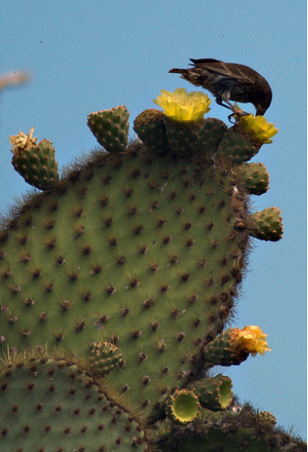
What did Darwin learn from the finches?
Each was adapted to eating a particular type of island food
He concluded that all finches came from one ancestral species
Cactus finch, photo courtesy of zrim, flickr creative commons

Slide 17
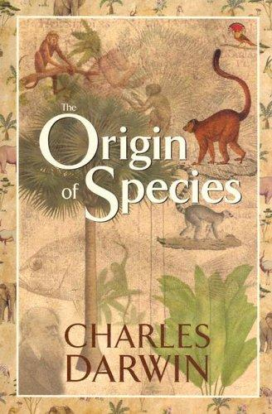
1859, Darwin published a book called:
“The Origin of Species”
Darwin concluded that evolution occurred through the process of natural selection.

Slide 18
Key Points to the Theory of Evolution by Natural Selection
1. Variation exists among individuals in a species. 2. Individuals will compete for resources
3. Competition would lead to the death of some, while others would survive 4. Individuals that had advantageous variations are more likely to survive and reproduce.
5. Selective pressures contribute by increasing or decreasing reproductive success in a species.

Slide 19
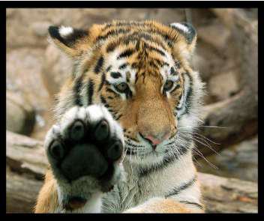
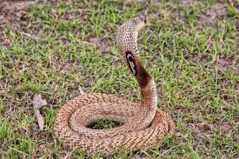
This process came to be known as Natural Selection The favorable variations are called Adaptations
What adaptations do tigers have?
Humans?
Snakes?
Video - evolution stated clearly
Photo courtesy of digitalART2, flickr creative commons

Slide 20
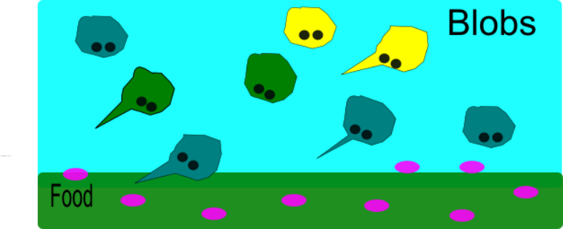
Example of Natural Selection
Say in a species of blob….there exists blobs of all shapes and sizes (variation)
Blobs eat the little purple organisms that live underground and on the surface.

Slide 21
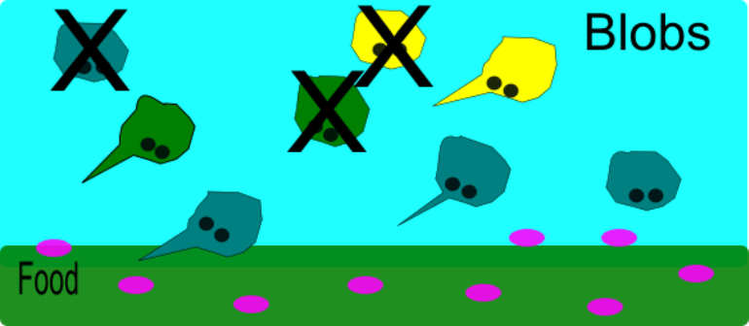
During a particularly hot year, food became less abundant (competition), blobs that had the ability to dig into the soil to get food had a better chance of thriving (survival).
Many blobs died that year…….

Slide 22
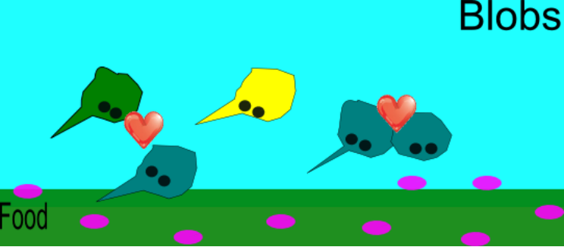
The ones that survived mated and passed their genes to the next generation. (reproduction)

Slide 23
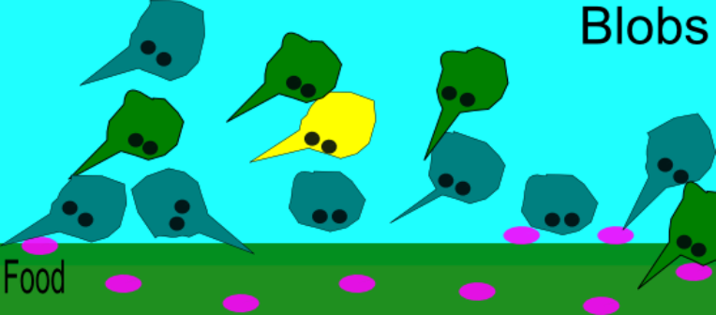
The next generation had more blobs with the pointed noses. That is NATURAL SELECTION.
Variation
Competition
Survival
Reproduction
Selective Pressures

Slide 24
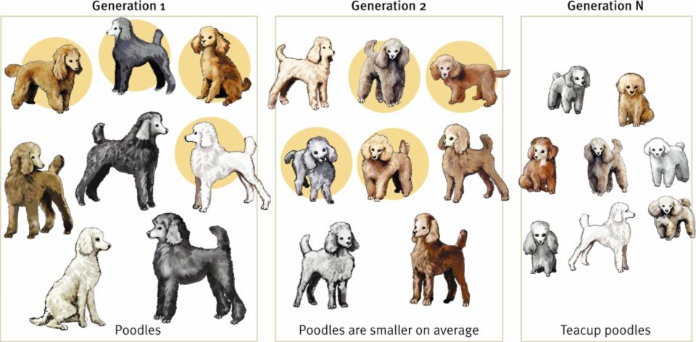
Artificial Selection - humans selected variations they found useful and bred animals and plants for those traits.

Slide 25
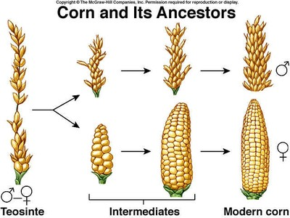
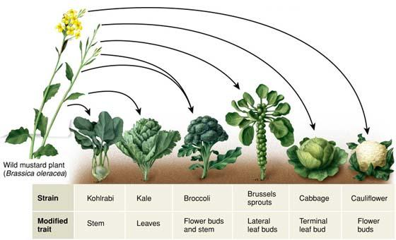
Much of our agriculture (food, animals, clothing) is a result of artificial selection that has
occurred over many generations.
We can influence the EVOLUTION
of a species

Slide 26
Checkpoint
1. What was the name of Darwin’s book?
2. The theory states that
a) individuals of a species have differences, called_________
b) these individuals ________________ for resources
c) some will die, others will ____________________
d) survivors will _________________________ and pass traits to offspring
3. Any trait that helps an organism survive is called an _______________________________
4. When humans influence evolution be breeding for desired traits, it is called _______________________________

Slide 27
Checkpoint
1. What was the name of Darwin’s book?
On the Origin of Species
2. The theory states that
a) individuals of a species have differences, called___variations_
b) these individuals ____compete____________ for resources
c) some will die, others will ____survive________________
d) survivors will ________reproduce_________________ and pass traits to offspring
3. Any trait that helps an organism survive is called an _____________adaptation__________________
4. When humans influence evolution by breeding for desired traits, it is called _____artificial selection____________

Slide 28
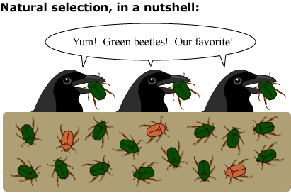
In 1-2 sentences, explain this image.

Slide 29
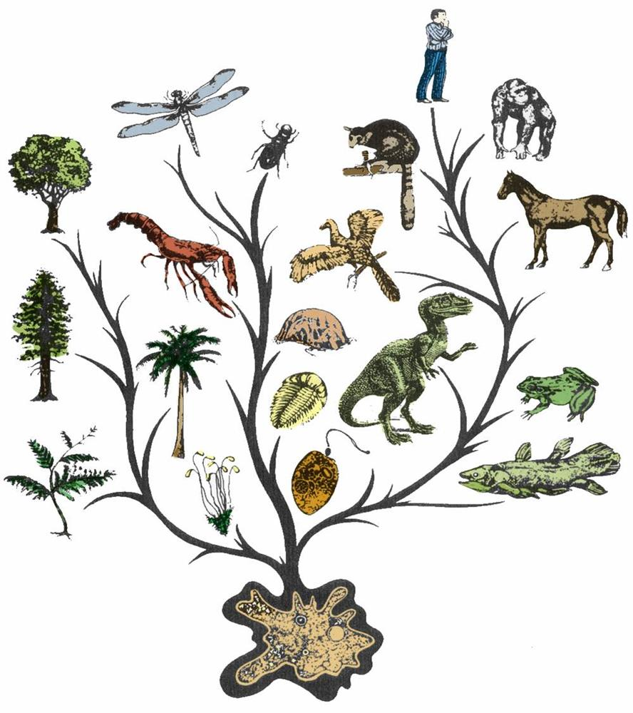
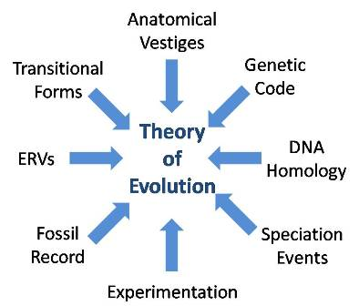
Evidence of Evolution
1. Fossils
2. Homologous structures
3. Analogous structures
4. Vestigial structures
5. Biochemistry & DNA
6. Embryologic Development
7. Direct Observation
video - Evidence of Evolution Stated Clearly

Slide 30
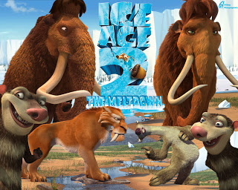
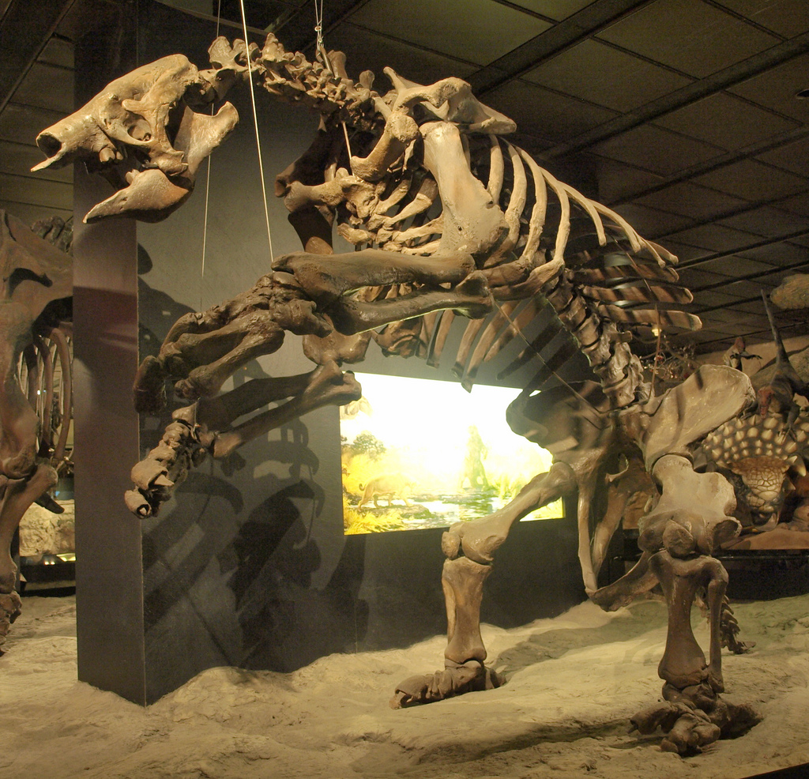
Fossil Evidence shows…..
similarities between extinct animals and animals that are alive
earth’s layers, and species that lived at each time

Slide 31
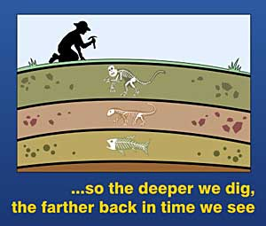

Slide 32
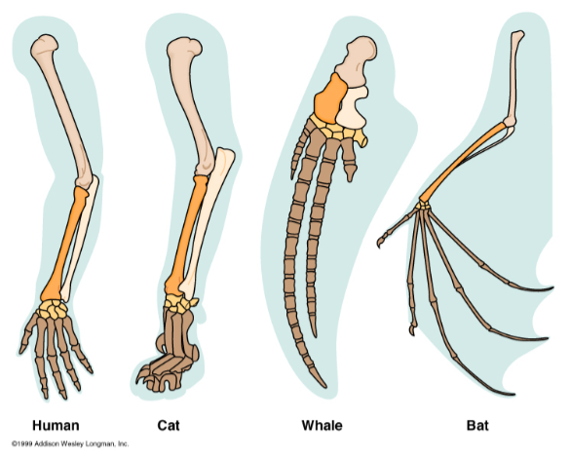
Homologous structures – these are parts of the body that are similar, but have different functions
ex. The flippers of whales, and the wings of birds
All forelimbs of vertebrates have the same pattern of bones.
•This is evidence of common ancestry.
•Common Descent - describes how a group of organisms share a most recent common ancestor.

Slide 33
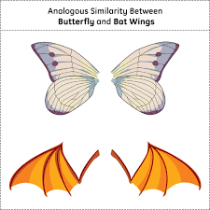
Analogous Structures - have the same function, but different structures. DO NOT indicate common descent, rather, they represent convergent evolution.
Convergent evolution - When 2 unrelated species evolve to have similar structures.
Ex. Bird wings and butterfly wings

Slide 34
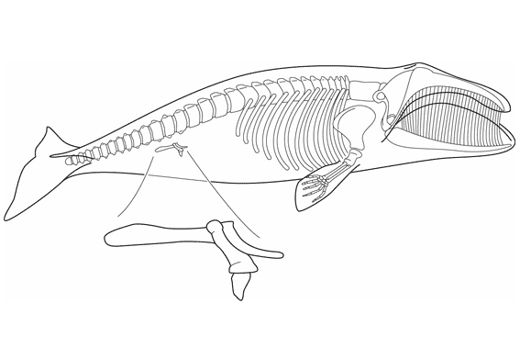
Vestigial Structures – these are structures that seem to have no function
Whales have pelvic bones that do not attach to legs
Watch a short video clip on whale evolution at PBS

Slide 35
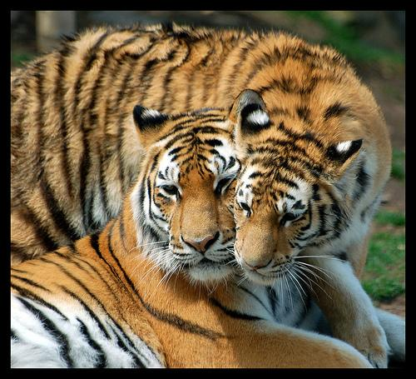
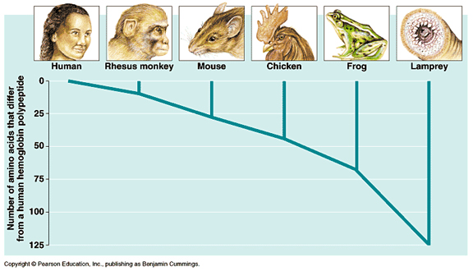
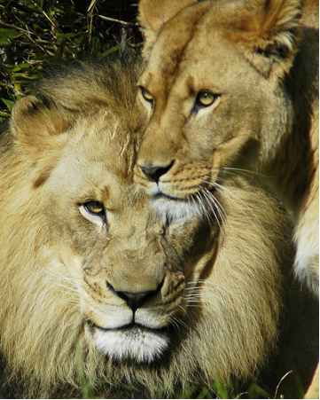
Biochemistry and DNA
When comparing the DNA of one species to another, more similarities are found in species that are more closely related.
Lion photo credit: ucumari Tiger photo credit: digitalART2

Slide 36
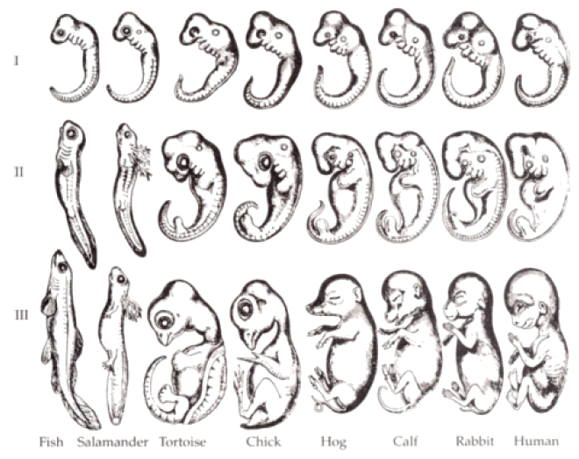
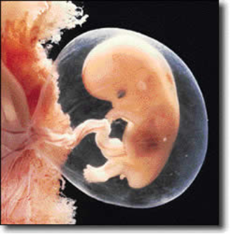
Embryological Development
Embryos of different species develop in almost identical ways.
Human fetus at 8 weeks

Slide 37
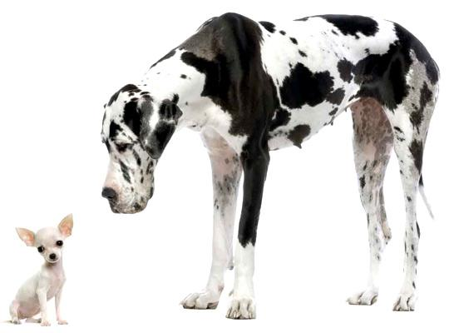
Direct observation of species change
Bacteria become resistant to antibiotics
Wolves were bred over many generations to become dogs (artificial selection) • and then bred further to create a variety of breeds

Slide 38
Checkpoint
1. ____________ evidence shows when organisms lived on the earth
2. Species that are closely related will have similar _______
3. A _______________ organ is one that has no function.
4. _________________ structures look the same but have different functions, like the arm of a human and the flipper of a whale.
5. ____________ of different animals develop in the same way.

Slide 39
Checkpoint
1. ____Fossil____ evidence shows when organisms lived on the earth
2. Species that are closely related will have similar __DNA_____
3. A _____Vestigial_______ organ is one that has no function.
4. ____Homologous________ structures look the same but have different functions, like the arm of a human and the flipper of a whale.
5. ____Embryos_______ of different animals develop in the same way.

