Slide 1
Living Organisms

Slide 2
The function of a plant root is to:
A: Make food for the plant
B: Get rid of waste products
C: Absorb water and minerals
D: Digest plant and animal matter
Notes:
C

Slide 3
Which similarity exists between amphibians and annelids (worms)?
A. They are both warm-blooded.
B. They both return to water to reproduce.
C. They both have endoskeletons made of bone.
D. They both exchange gases through their skin.
Notes:
D

Slide 4
Which is a reason most amphibians return to water during their life span?
A. to absorb and release gases
B. to become warm blooded
C. for reproduction and development
D. for digestion and excretion
Notes:
C

Slide 5
Which is a practical purpose for classification?
A. to facilitate the identification of unknown species
B. to explain the origin of unicellular organisms
C. to identify certain hereditary characteristics
D. to know the evolutionary history of species
Notes:
A

Slide 6
Which set contains only kingdoms that include autotrophs?
A. Protists, Animals, Plants
B. Protists, Plants, Bacteria
C. Plants, Fungi, Achaea
D. Plants, Bacteria, Fungi
Notes:
B

Slide 7
A paramecium absorbs materials from its environment and circulates. Which life function is described by these activities?
A. synthesis
B. reproduction
C. excretion
D. transport
Notes:
D

Slide 8
Which set contains kingdoms that contain only heterotrophs?
A. Protists, Fungi
B. Bacteria, Animals
C. Plants, Fungi
D. Animals, Fungi
Notes:
d

Slide 9
Scientists first attempted to develop a formal naming system by assigning Latin or Greek names to organisms. The names were very descriptive, but the naming system was of limited use. How did Carolus Linnaeus’s system of binomial nomenclature improve on the earlier system?
A. Scientists no longer had to understand Greek.
B. All scientists used the same name for an organism.
C. Common names were only used for organisms.
D. Each class of organism had a standard description.
Notes:
B

Slide 10
How are sexual reproduction and asexual reproduction different?
A. Sexual reproduction produces offspring identical to the parents, but asexual reproduction produces offspring with traits from both parents.
B. Asexual reproduction produces offspring identical to the parents, but sexual reproduction produces offspring with traits from both parents.
C. Sexual reproduction only occurs in multicellular organisms, but asexual reproduction only occurs in unicellular organisms.
D. Asexual reproduction only occurs in multicellular organisms, but sexual reproduction only occurs in unicellular organisms.
Notes:
B

Slide 11
Which is an example of an adaptation required for living in terrestrial environments?
A. gills
B. swim bladder
C. tough, scaly skin
D. eggs with a jelly coat
Notes:
c

Slide 12
Ecology

Slide 13
What would most likely be the result of a worldwide decline in nitrogen fixing bacteria?
A. a decrease in usable oxygen worldwide
B. an increase in denitrification worldwide
C. a decrease in usable nitrogen worldwide
D. an increase in the protein production by all plant species.
Notes:
C

Slide 14
Which has the greatest impact on the rate of photosynthesis?
A. the amount of oxygen present in the atomsphere.
B. the rate of aerobic respiration in a plant's cells.
C. the rate of anaerobic respiration in a plant's cells.
D. the amount of carbon dioxide present in the atmosphere.
Notes:
D

Slide 15
What is the relationship between a community and a population?
A. The population size of organisms in a population is larger than in a community of organisms.
B. A community consists of members of the same species living in different areas but in a population they all live in the same area.
C. A population of organisms is defined a group of interacting communities all living in the same geographic area.
D. A community of organisms is defined as a group of populations all living in the same geographic range.
Notes:
D

Slide 16
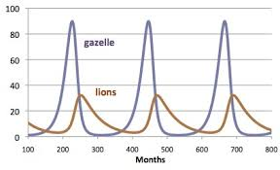
The diagram below displays a graph of Lynx and Hare populations: Based on the graph, what keeps the lynx population from experiencing constant growth?
A. The fluctuation in the hare population size.
B. A vegetarian diet.
C. The expontential growth of the hare population.
D. Competition with other predators for the hare as a prey species.
Notes:
A

Slide 17
Which describes the impact predators have on the population growth of the prey?
A. Predators aid in maintaining the prey population.
B. Predators only increase the prey population growth.
C. Predators drastically decrease the prey population growth only.
D. Predators have no impact on the growth or decline of prey populations.
Notes:
A

Slide 18
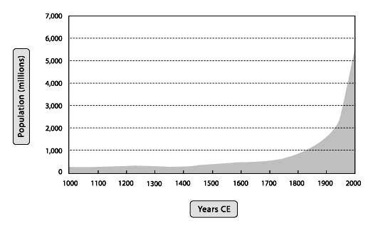
Which statement is a valid inference that can be made if human population continues to grow a rate similar to that shown between 1000 AD and 2010 AD?
A. Future ecosystems will be extremely stressed and many animal habitats will be destroyed.
B. Global warming will decrease as a result of a lower demand for fossil fuels.
C. One hundred years after all resources are used up, the human population will level off.
D. All environmental problems can be solved without reducing the growth rate of human populations around the globe.
Notes:
A

Slide 19
Which change to an ecosystem will most likely have the strongest negative impact?
A. Planting additional trees to replace those that have been cut down.
B. Introducing a non-native species to an ecosystem.
C. Adding additional freshwater sources.
D. The destruction of all primary consumers (insects) in a forest.
Notes:
D

Slide 20
Many cars are equipped with a device that helps remove hydrocarbons, oxidies and other atomospheric pollutants from car exhaust. As a result, this device helps to
A. Increase the production of ozone.
B. Decrease the production of smog.
C. Increase the emission of nitrogen.
D. Decrease the purchase of foreign made cars.
Notes:
B

Slide 21
What happens to the energy that was in a fox's body once it has been used for maintaining body temperature?
A. It is taken up by decomposers that consume the fox.
B. It moves into the surrounding envronment as heat energy.
C. It stays in the fox through metabolism of food.
D. It travels to the next trophic level when the fox is eaten.
Notes:
b

Slide 22
Which of the following issues has the largest impact on increasing the health of North Carolina ecosystems.
A. Beach erosion
B. Industrialization
C. Urbanization
D. Green Initiatives to help heal the environment
Notes:
D

Slide 23
The burning of fossil fuels may cause all of the following except...
A. Acidic precipitation
B. Global Warming
C. Smog
D. The ozone hole
Notes:
D

Slide 24
Nutrients move through an ecosystem in
A. Biogeochemical cycles
B. Water cycles
C. Energy pyramids
D. Ecological pyramids
Notes:
A

Slide 25
Biochemistry
Notes:
A

Slide 26
Which organic compounds necessary for life are formed by a sugar bonded to a phosphate group and a nitrogenous base?
A. lipids
B. proteins
C. nucleic acids
D. carbohydrates
Notes:
c

Slide 27
Which organic molecule serves as the main source of energy for cells?
A. amino acids
B. glucose
C. proteins
D. starch
Notes:
b

Slide 28
Which characteristic best explains why carbon is relevant to living organisms?
A. Carbon is the most common element on Earth.
B. Carbon can form a wide variety of molecules.
C. Many carbon isotopes are radioactive.
D. Many carbon allotropes occur in nature.
Notes:
b

Slide 29
Peptide bonds in proteins can be broken down by the enzyme peptidase. Adrian orders a hamburger and French fries for lunch. He adds cheese and mayonnaise to his hamburger, and then sits down to eat lunch with his friends. Which structure would most likely result from the action of peptidase in Adrian’s small intestine?
A. lipid
B. glucose
C. amino acid
D. hydrocarbon

Slide 30
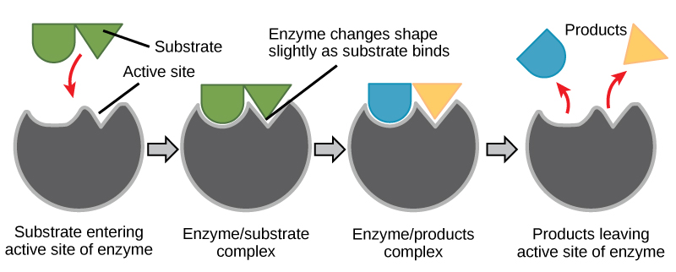
Which molecule is the biological catalyst?

Slide 31
An enzyme is located in the small intestine, which has a pH between 7 and 9. Based on this information, which statement is most accurate?
A. The enzyme is a lipid and requires an acidic environment.
B. The enzyme is a nucleic acid and requires a basic environment.
C. The enzyme is a carbohydrate and requires an acidic environment.
D. The enzyme is a protein and requires a neutral environment
Notes:
D

Slide 32
What is the difference between a saturated and unsaturated fat?
A. Saturated is liquid at room temperature and unsaturated is solid
B. Saturated fat has a single bond and unsaturated fat has a double bond
C. Saturated is found in plants and unsaturated is found in animals
D. Saturated fat tests positive for benedicts and unsaturated does not

