Slide 1
Patterns of Heredity

Slide 2
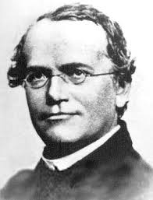

Slide 3

Not all traits are simply inherited by dominant and recessive alleles (Mendelian Genetics). In some traits, neither allele is dominant or many alleles control the trait. Below are different ways in which traits can be inherited from parents to offspring.

Slide 4
5 Different Modes of inheritance

Slide 5

1. Incomplete dominance
Definition:
    Neither allele for a gene dominates
    Phenotype of the heterozygous offspring will be a blend of the 2 homozygous parents.
Homozygous Parent
Heterozygous Offspring
Homozygous Parent

Slide 6
Incomplete dominance
      Ex: A homozygous white flower crossed with a homozygous red flower will produce all heterozygous pink flowers.
Homozygous Parent
Heterozygous Offspring
Homozygous Parent

Slide 7
Incomplete dominance
Notation:
    Alleles are all capital letters because neither one dominates the other. So one of the alleles has a prime ( ‘ ) on it to represent an alternate expression of the gene.

Slide 8
  Always make a KEY to show the genotypes and the resulting phenotypes.
  Still supports Mendel’s Law of Independent Assortment

Slide 9

Ex. 1) In a certain species of flowers, snapdragons, the combined expression of both alleles for flower color produces a new phenotype-pink. A red snapdragon is homozygous and is crossed with a homozygous white snapdragon. What are the genotypic and phenotypic ratios of this cross?

Slide 10

Key:
Red = RR
White=R’R’
Pink = RR’
P cross = RR x R’R’
R R
G: 100% RR’
P: 100% PINK
R’
R’
RR’
RR’
RR’
RR’

Slide 11
Ex. 2) Then cross the F₁ generation and what are the genotypic and phenotypic ratios of this cross?

Slide 12
Key:
Red = RR
White=R’R’
Pink = RR’
P cross = RR’ x RR’
G: 1RR:2RR’:1R’R’
P: 1Red:2Pink:1white
R R’
R
R’
RR
RR’
RR’
R’R’

Slide 13
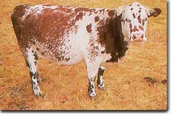
2. CoDominance
Definition:
  Both alleles are expressed EQUALLY

Slide 14
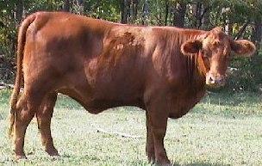
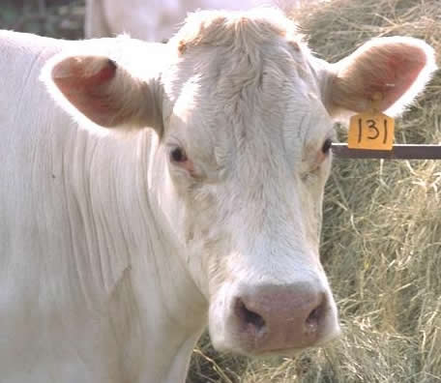
CoDominance
  Phenotypes of heterozygous offspring are showing both traits!
    Ex: red cows crossed with white will generate roan cows. Roan refers to cows that have red coats with white blotches.
X
=

Slide 15
CoDominance
Notation:
  2 different alleles (capital letters) are used
  Always make a KEY to show the genotypes and the resulting phenotypes

Slide 16
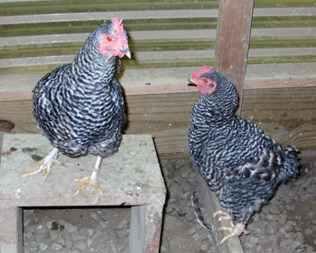
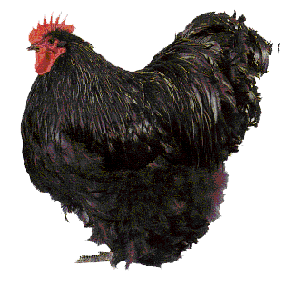
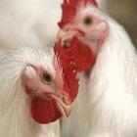
In chickens, black-feathered is not wholly dominant over white-feathered, so heterozygous chickens are black and white checkered. Cross two heterozygous chickens. What would the appearance of their offspring be?

Slide 17
Key:
Black= BB
White= WW
Checkered= BW
P cross = BW x BW
Phenotype:
1Black:
2 Checkered:
1white
B W
B
W
BB
BW
BW
WW

Slide 18
In shorthorn cattle, the hybrid between red and white is called a roan. What phenotypes would result in the cross of a roan and a white?

Slide 19
Key:
Red= RR
White= WW
Roan= RW
P cross= RW x WW
Phenotype:
2 Roan: 2 white
R W
W
W
RW
WW
RW
WW

Slide 20
Turn to page 22

Slide 21
Mode of Inheritance | Define | Notations | Example
 | Neither allele for a gene dominates so the hybrid phenotype is a BLEND of the homozygous parents | Alleles are all capital letters because neither one dominates the other. One of the alleles has a prime ( ‘ ) on it to represent an alternate expression of the gene. | A homozygous white flower is crossed with a homozygous red flower and produces all pink flowers. Blended trait is the HYBRID KEY: Red = RR White = R’R’ Pink = RR’
Incomplete
Dominance

Slide 22
Mode of Inheritance | Define | Notations | Example
 | Both alleles are expressed equally | 2 different capital letters (alleles) are used | A black chicken is crossed with a white chicken and black and white checkered chickens are produced. KEY: Black = BB White = WW Checkered = BW
Codominance

Slide 23
3.Multiple alleles
Definition:
  More than 2 alleles for a single gene can control a trait.
Multiple alleles must be studies by looking at the entire population of species.

Slide 24
Multiple alleles
Each individual carries only 2 alleles for any gene (one on each homologous chromosome).
  In this form of inheritance, a trait can have 1 gene, but 100 alleles for that gene.

Slide 25

Multiple alleles
Ex: The human blood group can be any combination of A, B,
and O

Slide 26
Multiple alleles
  The alleles are I^{A}, I^{B}, and i
    Alleles A and B are CODOMINANT
    Alleles i (“O”) is recessive

Slide 27
Notation:
  The possible genotypes/phenotypes:
GENOTYPES |  | PHENOTYPES
Homozygous type A | I^{A}I^{A} | type A blood
Heterozygous type A | I^{A}i | type A blood
Homozygous type B | I^{B}I^{B} | type B blood
Heterozygous type B | I^{B}i | type B blood
Codominant type AB | I^{A}I^{B} | type AB blood
Recessive type O | ii | type O blood

Slide 28
Multiple alleles
  NOTE: the “i” is dropped from the genotype of A and B when the phenotype is written.
  (Genotype I^{A}i is type A blood)

Slide 29

Interesting fact:
In the U. S., about 45% of the population is type O, 42% type A, 10% type B, and only 3% type AB.

Slide 30
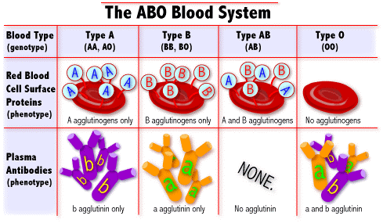

Slide 31
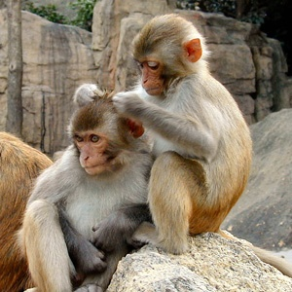
The positive and negative of a blood type is called the Rh factor, it is a totally separate gene with Rh⁺ (RR or Rr) and Rh–alleles (rr)
  If you have the protein = Rh +
  If you DO NOT have the protein = Rh –

Slide 32
In the U. S., about 85% of the population is Rh⁺ and 15% Rh–.
Thus the chances of someone being O- [having both ii and rr] would be 45% × 15% = 6.75%.

Slide 33
The most rare blood type would be AB-, about 0.45% of the population.
    O is the universal donor
    AB is the universal receiver

Slide 34

1) If a person of blood group AB marries one belonging to group O, what could be the possible genotypes and phenotypes of their offsprings’ blood types?

Slide 35
P cross = I^{A}I^{B} x ii
I^{A} I^{B}
Genotypes:
2 I^{A}i : 2 I^{B}i
Phenotypes:
2 Type A: 2 Type B
i
i
I^{A}i
I^{B}i
I^{A}i
I^{B}i

Slide 36
If a father is homozygous blood type A and the mother is heterozygous blood type B. What could be the possible genotypes and phenotypes of their offspring’s blood types?

Slide 37
P cross = I^{A}I^{A} x I^{B}i
I^{A} I^{A}
Genotypes:
2 I^{A}i : 2 I^{A}I^{B}
Phenotypes:
2 Type A: 2 Type AB
I^{B}
i
I^{A}I^{B}
I^{A}I^{B}
I^{A}i
I^{A}i

Slide 38
2 Types of Chromosomes:
1. Sex chromosomes- last pair of chromosomes—23rd pair for humans
XX = female
XY = male

Slide 39
2. Autosomal chromosomes or Autosomes
All other pairs of chromosomes – 1 -22nd pair in humans

Slide 40

4. Sex-linked traits
(x-linked)
Other genes besides the alleles for sex are located on the sex chromosomes.

Slide 41

Definition:
These traits will occur MORE frequently in males than females, such as color blindness and hemophilia.

Slide 42
WHY?
  Alleles for a gene may be present on the X chromosome but absent on the Y. These are called sex-linked genes.

Slide 43
  This means that males may inherit just one allele for a characteristic and that allele will be expressed, whether it is dominant or recessive, because it is the only allele present on their X chromosome.

Slide 44
  X-linked traits most likely will be recessive to the normal condition and the Y chromosome lacks the gene for a trait, so males have a higher chance of having the disorder.

Slide 45
These traits generally do NOT show up in females since females have genes on both their X chromosomes.

Slide 46
Notation:
  The alleles for these traits are written as superscripts on the X chromosome ONLY.

Slide 47
No alleles are written on the Y chromosome!
  Ex: Colorblind male = X^{b}Y and Normal male = X^{B}Y
Heterozygous Females are known as carriers, X^{B}X^{b}

Slide 48
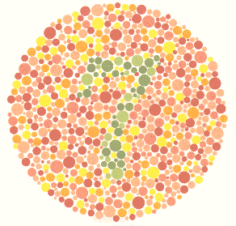
Ex.1) Color blindness is a sex-linked trait that is caused by a recessive allele. A colorblind man marries a woman that is homozygous for normal vision.

Slide 49
P cross X^{N}X^{N} x X^{n}Y
What possible types of vision could be found if they had boys?
X^{N} X^{N}
Normal
X^{n}
Y
X^{N}X^{n}
X^{N}X^{n}
What possible types of vision could be found if they had girls?
X^{N}Y
X^{N}Y
Normal

Slide 50
Ex.2) A girl of normal vision, whose father was colorblind, marries a colorblind man. What types of vision could be found in their children?

Slide 51
P cross = X^{N}X^{n} x X^{n}Y
What types of vision could be found in their children?
X^{N} X^{n}
50% Normal vision
and 50% colorblindness
X^{N}X^{n}
X^{n}X^{n}
X^{n}
Y
X^{N}Y
X^{n}Y

Slide 52

5. Polygenic inheritance
Traits are determined by many genes
They may or may not be found on the same chromosome
Each gene may have more than 2 alleles

Slide 53

The phenotypes may vary depending on the number of dominant and recessive alleles in the genotype

Slide 54

Traits that show great variability are a result of polygenic inheritance
  Ex: eye color, skin color, height, facial features

Slide 55
Environment & genes
The environment can determine whether or not a gene is fully expressed or expressed at all.

Slide 56

Internal and external environments can affect phenotypes:
1. Influence of internal environment:
~ Hormones based on sexes (testosterone, estrogen)

Slide 57




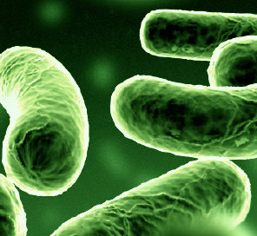
2. Influence of external environment:
~Temperature
~Light
~Infectious agents (viruses, bacteria)
~Chemicals
~Nutrition (PKU)

Slide 58

All of these can influence the expression of genes.

Slide 59
Turn to page 22

Slide 60
Mode of Inheritance | Define | Notations | Example
 | More than 2 alleles for a single gene can control a trait | A & B are codominant Use capital ”I” with superscripts for specific allele O is recessive Use lowercase “i” | BLOOD TYPES Type O = ii Heterozygous Type A= I^{A}i Homozygous Type A = I^{A}I^{A} Type AB = I^{A}I^{B} Heterozygous Type B= I^{B}i Homozygous Type B = I^{B}I^{B}
Multiple
Alleles

Slide 61
Mode of Inheritance | Define | Notations | Example
 | Traits are carried on the X chromosomes | The alleles for these traits are written as superscripts on the X chromosome ONLY. No alleles are written on the Y chromosome! | COLORBLINDNESS,HEMOPHILIA Colorblind male = X^{b}Y Normal male = X^{B}Y Colorblind female= X^{b} X^{b} Normal female = X^{B}X^{B}, X^{B}X^{b} Carrier = X^{B}X^{b}
Sex
Linked

