Slide 1
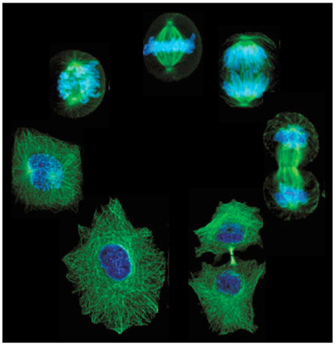
5.1 The Cell Cycle
The cell cycle is the regular pattern of growth, DNA duplication and cell division that occurs in eukaryotic cells.

Slide 2
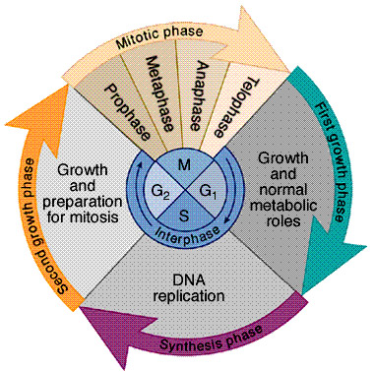
The Cell Cycle

Slide 3
Main Idea: The cell cycle has THREE main stages and then an end action
Gap 1 (G1)
Synthesis (S) 1. Interphase
Gap 2 (G2)
2. Mitosis (M)
3. Cytokinesis
Gap 1, Synthesis and Gap 2
Together make up
Interphase.

Slide 4
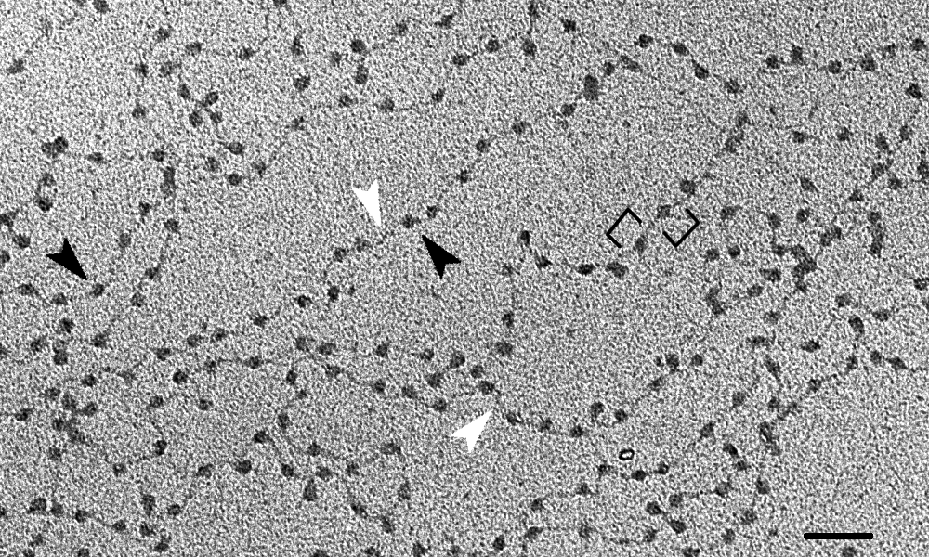
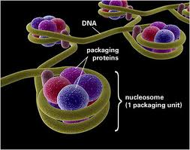
During interphase, when a cell is not dividing, the DNA is loose and stringy-looking.
At this stage, the DNA is called chromatin.

Slide 5
Interphase
During Gap1 (G1), the cell carries out its normal activities, grows and makes organelles

Slide 6
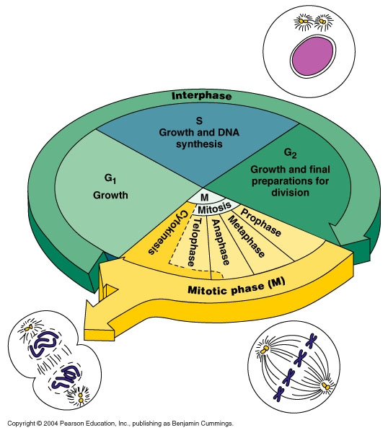
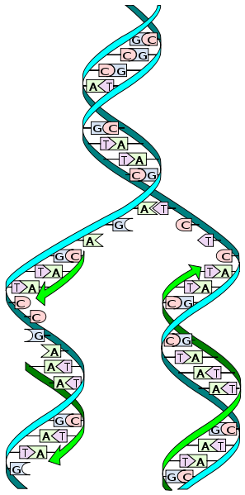
Interphase
During the Synthesis (S) phase,the cell makes a copy of its DNA

Slide 7
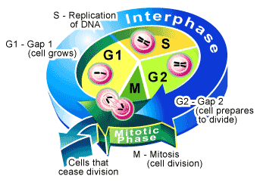
Interphase
In the Gap 2 (G2) phase, the cells continue normal functions, undergoes additional growth , double checks for damage to DNA and prepares to divide.

Slide 8
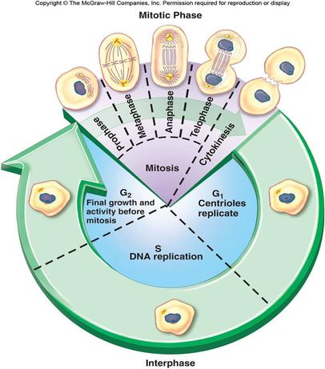
The next stage of the cell cycle is Mitosis (m).
Mitosis is the division of the cell nucleus and its contents.
The 4 phases are
Prophase
Metaphase
Anaphase
Telophase

Slide 9
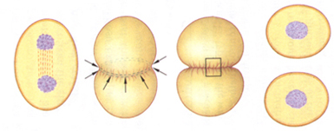
After division of the nucleus, the cell undergoes cytokinesis.
Cytokinesis is the division of the cell cytoplasm , resulting in two daughter cells that are genetically identical to the original cell.

Slide 10
Main Idea: Cells divide at different rates
Prokaryotes generally divide much faster than eukaryotes.
The rate at which your cells divide depends upon your body’s need for those cells.
The rate of cell division in embryos and children is faster than that of adults.
The rate of cell division in an adult varies within the different tissues.

Slide 11
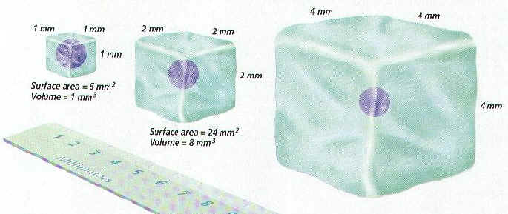
Main Idea: Cell Size is Limited
If cells were too small, they could not contain all the needed organelles and molecules.
If cells were too big, materials could not be transported in and out of the cell membrane efficiently.
When cells increase in size, their volume increases faster than their surface area.

Slide 12
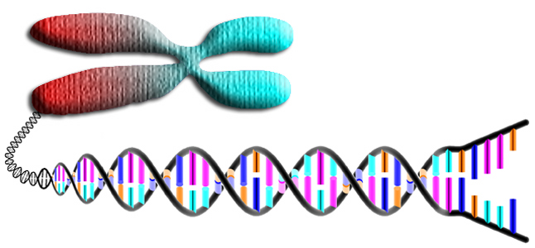
5.2 Mitosis & Cytokinesis
Main Idea: Chromosomes condense at the start of mitosis
A chromosome is a long strand of DNA that consists of a number of genes.

Slide 13
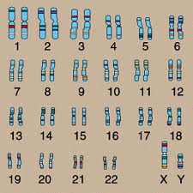
You have 46 chromosomes in each of your body cells.

Slide 14
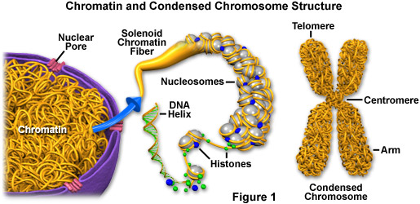
Before the cell undergoes mitosis, the chromatin “condenses” or becomes tightly coiled around certain protein molecules called histones.
This prevents the chromosomes from becoming tangled up during mitosis.

Slide 15
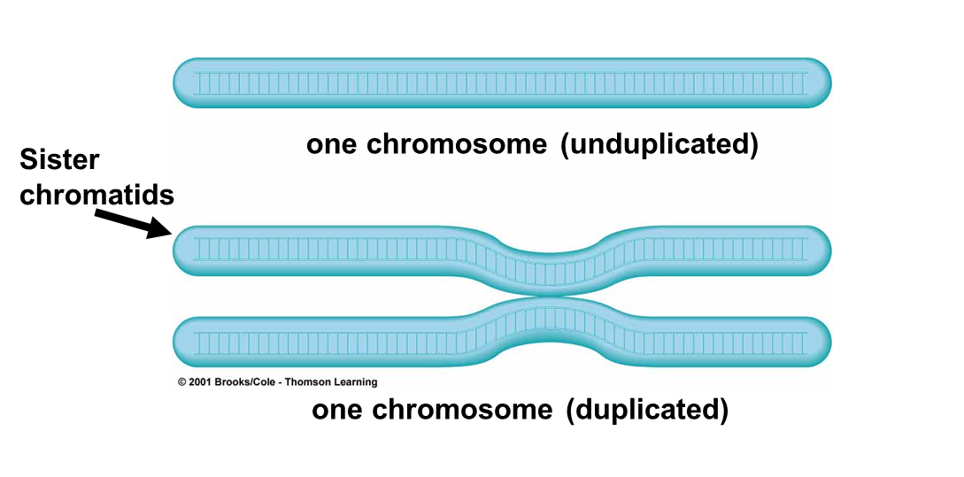
After the chromatin condenses, they form chromosomes.
Remember, the chromosome was copied during the S phase of the cell cycle.
The chromosome now has an “X” shape with each side consisting of identical DNA.

Slide 16
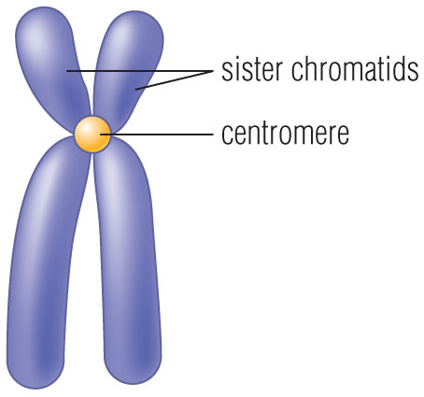
One half of a duplicated chromosome is called a chromatid.
The two identical chromatids are called sister chromatids.
Sister chromatids are held together at the centromere.

Slide 17
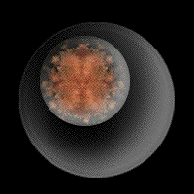
Main Idea: Mitosis and cytokinesis produce two genetically identical daughter cells.
Mitosis is the division of the cell nucleus and its contents.
Purposes of mitosis: To produce two new daughter cells with the exact same kind and number of chromosomes as the original (parent) cell.

Slide 18
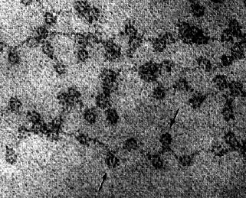
Main Idea: Mitosis and cytokinesis produce two genetically identical daughter cells.
During interphase, because the DNA is still loose chromatin, the chromosomes are not visible.
Chromatin in chicken red blood cell

Slide 19
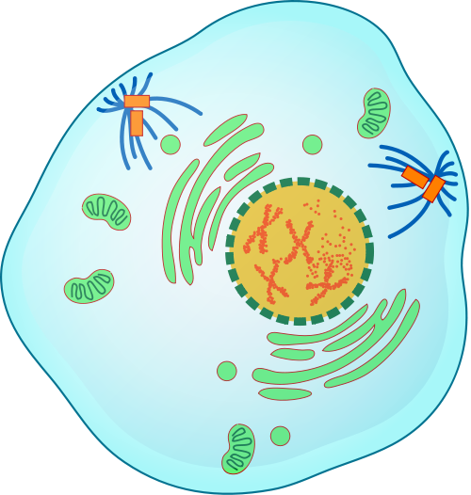
Stages of Mitosis: Prophase
The chromatin condenses into tightly coiled chromosomes.
The nuclear membrane (envelope) breaks down.
Centrioles move to opposite poles of the cell. Spindle fibers form.

Slide 20
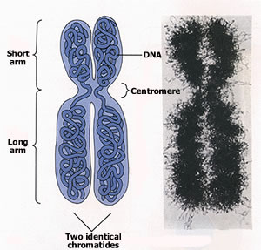
Prophase
The chromosome was copied during interphase, and now looks like an “X”.

Slide 21
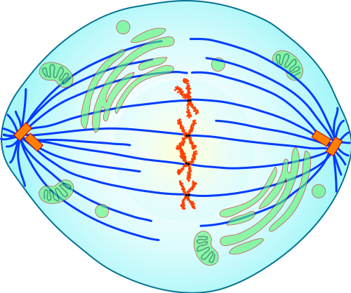
Stages of Mitotis: Metaphase
Chromosomes line up along the cell’s equator.
Spindle fibers attach to each chromosome

Slide 22
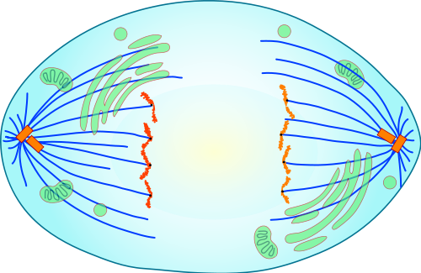
Stages of Mitosis: Anaphase
Anaphase: Sister chromatids separate to opposite sides of the cell.

Slide 23
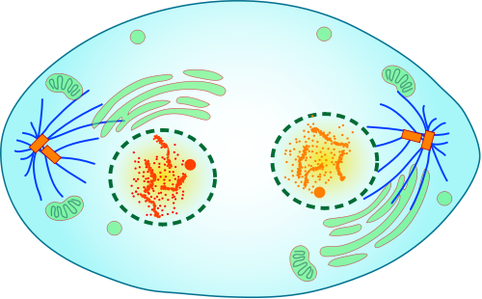
Stages of Mitosis: Telophase
Telophase:
A complete set of identical chromosomes are positioned at each pole of the cell.
Nuclear membranes form.
Chromosomes uncoil back into chromatin. Spindle fibers fall apart.

Slide 24
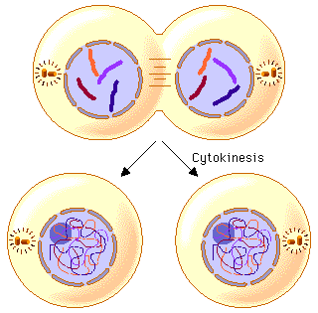
Following mitosis, cytokinesis pinches the cell membrane (in animal cells) and divides cytoplasm into two daughter cells.
Each new cell has a genetically identical nucleus.

Slide 25
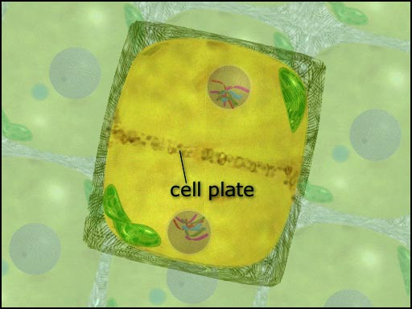
During cytokinesis in plant cells, a plate forms between the two nuclei which becomes a new cell wall.

Slide 26
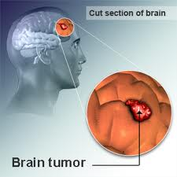
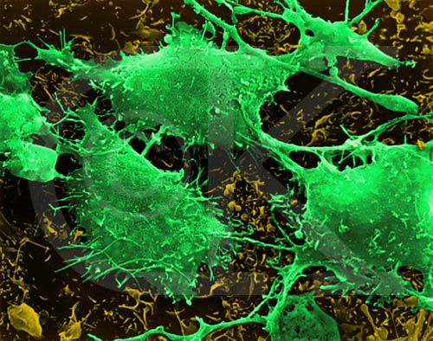
Main Idea: Cell division is uncontrolled in cancer
Cancer is a class of diseases caused by uncontrolled cell division.
Brain cancer cells

Slide 27
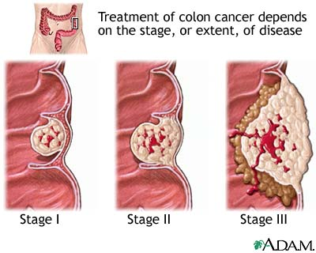
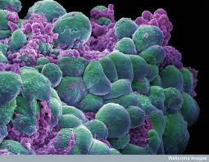
Cancer cells form disorganized
clumps called tumors.

Slide 28
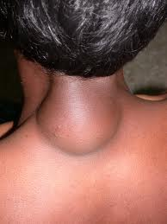
Main Idea: Cell division is uncontrolled in cancer
A tumor is benign if the cancer cells remain clustered together.
They are usually harmless and can be removed.
lipoma

Slide 29
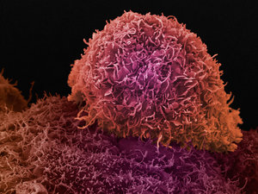
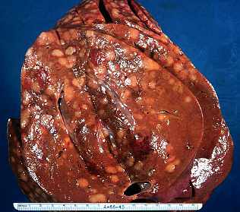
A tumor is malignant if the cancer cells spread to other parts of the body.

Slide 30
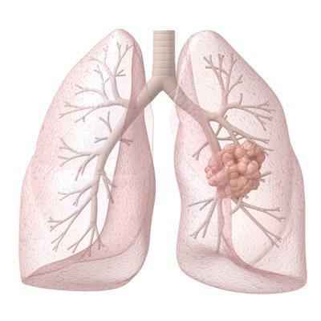
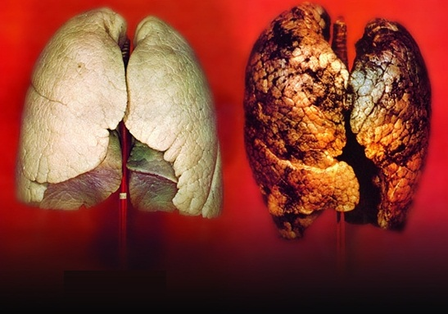
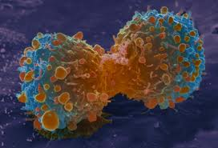
Tumors are harmful because cancer cells do not perform the specialized functions needed by the body and crowd out normal cells.

Slide 31
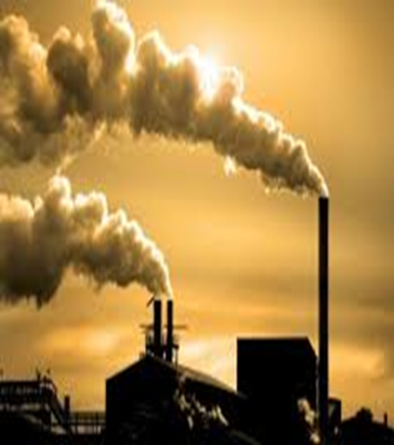
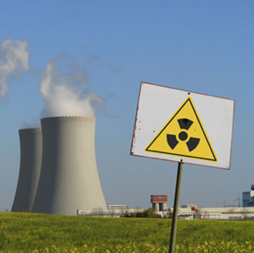
Most cancer cells carry DNA mutations or mistakes.
Some of these mutations can be caused by exposure to environmental agents called carcinogens.

Slide 32
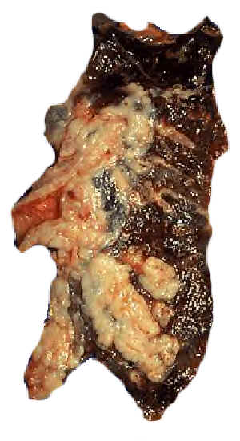
Carcinogens are substances that produce or promote cancer
Small cell carcinoma (oat cell) of the lung in a smoker

Slide 33
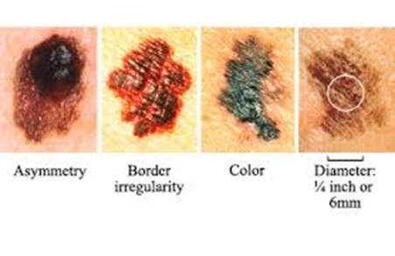
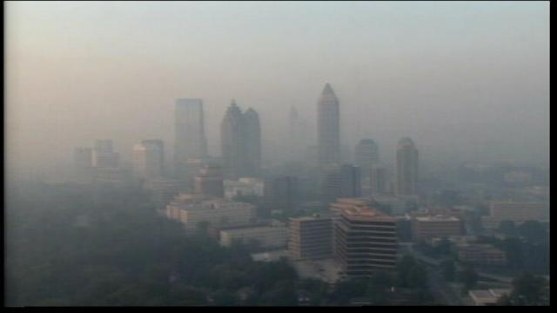
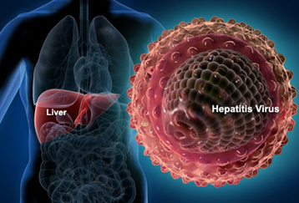
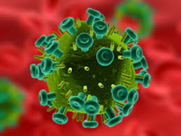
Examples of Carcinogens:
UV Radiation:
Nuclear reactor meltdowns, sun and tanning bed exposure, X-rays
Can cause- genetic mutations, skin cancer, thyroid cancer, leukemia
Air Pollutants: smog, industrial smoke, car fumes
Can cause- lung cancer, nose cancer, leukemia
Viruses:
Human Papallomavirus (HPV)
Hepatitis, HIV
Can Cause:
Organ failure, some cancers, decreased immune system

Slide 34
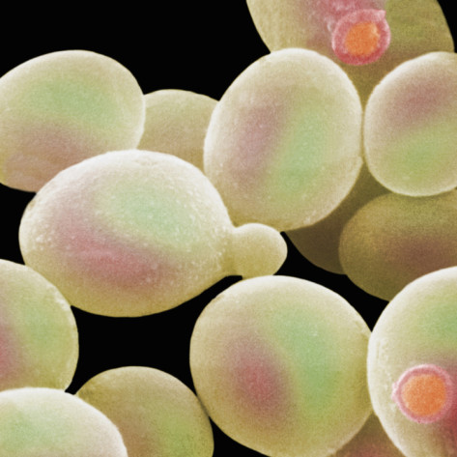
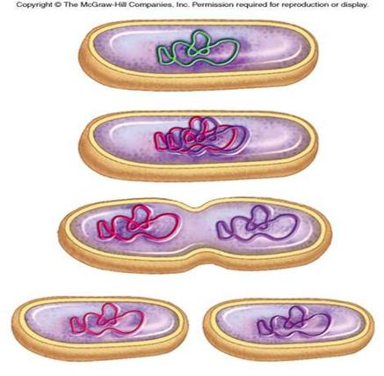
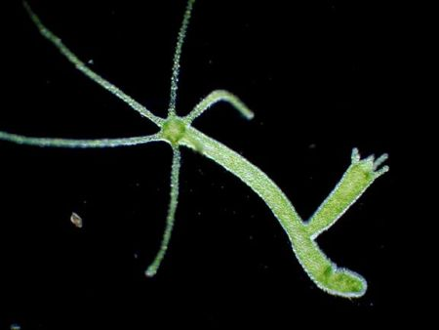
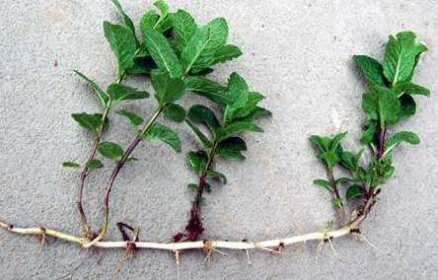
5.4 Asexual Reproduction

Slide 35
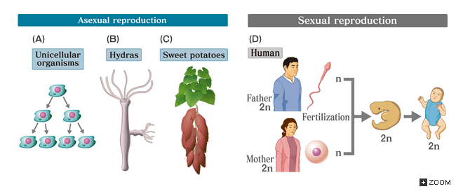
Main Idea: Binary fission is similar in function to mitosis
Reproduction is a process that makes new organisms from one or more parent organisms.
It happens in two ways: sexually & asexually

Slide 36
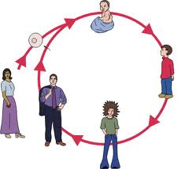
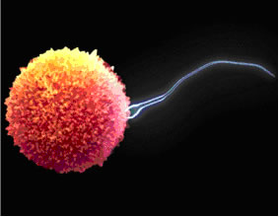
Sexual reproduction involves the joining of two cells called gametes (eggs and sperm cells), one from each of two parents.

Slide 37
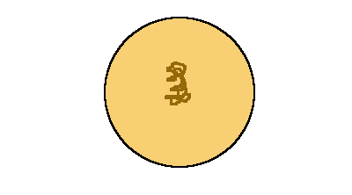
Asexual Reproduction
Asexual reproduction is the production of offspring from a single parent and does not involve the joining of gametes.
The offspring are genetically identical to each other and the parent.

Slide 38
Asexual reproduction is the primary form of reproduction for single-celled organisms such as bacteria, and protists.
Many plants, some animals and fungi can reproduce asexually as well.

Slide 39
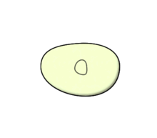
Main Idea: Binary fission is similar to mitosis
Binary fission is the asexual reproduction of a single-celled organism by division into two new organisms.

Slide 40
Main Idea: Binary fission is similar to mitosis
Like mitosis, binary fission results in two daughter cells that are genetically identical to the parent cell.
Video clip of protozoa undergoing binary fission

Slide 42
Advantages and Disadvantages of Asexual and Sexual Reproduction
Advantages of Sexual Reproduction
lots of genetic variation
able to live in a variety of environmental settings
able to adapt to changes in the environment

Slide 43
Advantages and Disadvantages of Asexual and Sexual Reproduction
Advantages of Asexual Reproduction
Does not require special cells or a lot of energy
Produces many offspring quickly
In a favorable, unchanging environment creates large, thriving populations

Slide 44
Advantages and Disadvantages of Asexual and Sexual Reproduction
Disadvantages of Sexual Reproduction
Needs more time & energy (finding mate, taking care of offspring)
Produces small populations

Slide 45
Advantages and Disadvantages of Asexual and Sexual Reproduction
Disadvantages of asexual reproduction
Population is genetically identical, so there is a limited ability to adapt to a changing environment
Population may face massive die-off if environment changes

Slide 46
Main Idea ↓Specialized cells perform specific functions
Your body began as a fertilized egg.
If the egg simply divided to make lots of identical cells, it would not form a baby.
To form the complex structures that make up your body and the body of other complex organisms, cells must specialize.

Slide 47
The process by which unspecialized cells develop into their special forms and functions is called cell differentiation.
Outer: skin cells
Middle: bone cells
Inner: intestines

Slide 48
Main Idea ↓Specialized cells perform specific functions.
Almost every cell in your body has a full set of DNA.
Each type of cell uses only the DNA needed to carry out its function

Slide 49
Main Idea ↓ Stem cells can develop into different cell types
Stem cells are a unique type of body cells that have the ability to
divide and renew themselves for a long period of time
remain undifferentiated
develop into almost any type of specialized cell

Slide 50
Stem Cell Classification

Slide 51
Main Idea ↓ Stem cells can develop into different cell types
Stem cells are used to treat patients with leukemia and lymphoma (forms of cancer)
Stem cells may cure other diseases or replace damaged tissues and organs

