Slide 2
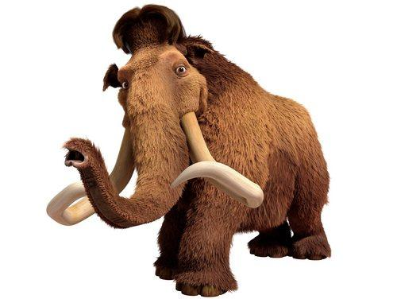
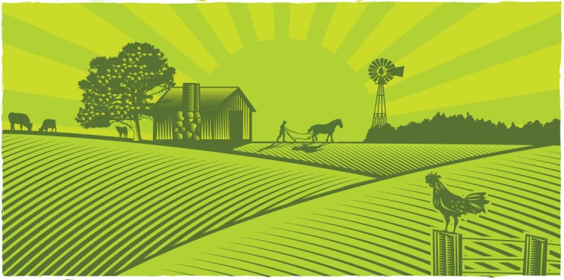
A Changing Landscape
Humans are the main source of environmental change.
Activities that affect the biosphere are hunting, gathering, agriculture, industry and urban development.

Slide 3
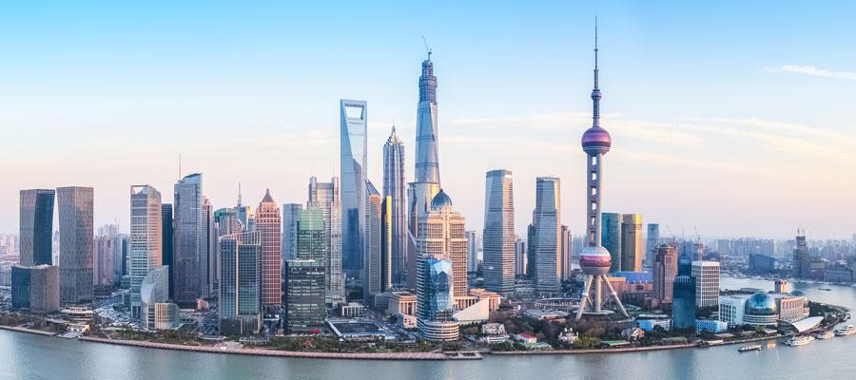
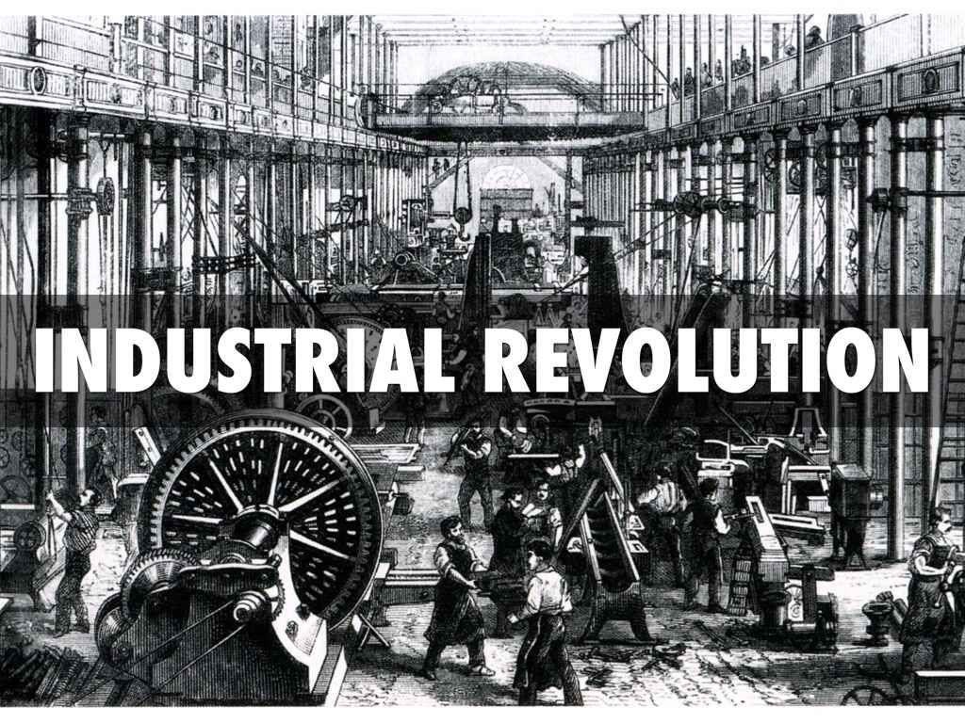
Shanghai, China
Industry used more resources and produced more pollution than ever before.
Cities also produce more pollution.

Slide 4
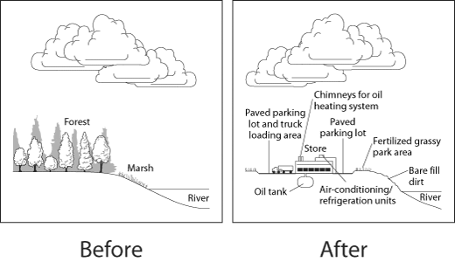
The impact of human activities on resources
Human activities can affect the quality and supply of resources.

Slide 5
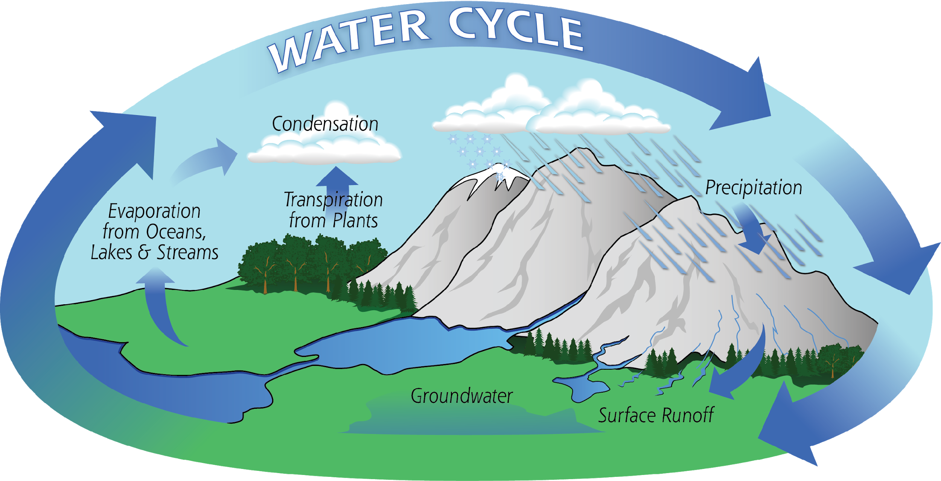
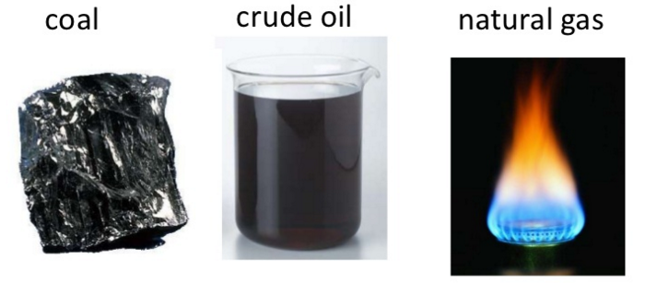
Renewable and Nonrenewable Resources
Resources may be classified as:
Renewable resources: those that a natural process can replace.
Nonrenewable resources: those that cannot be replaced by a natural process.
Fossil Fuels take millions of years to form.

Slide 6
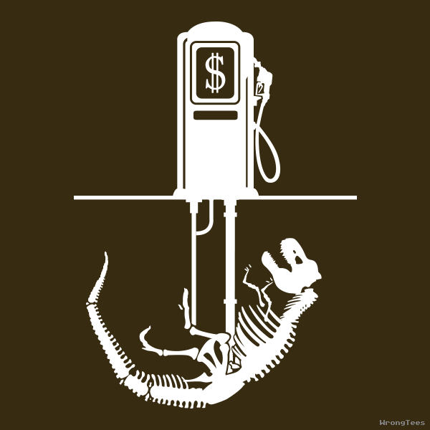
Fossil Fuels

Slide 7
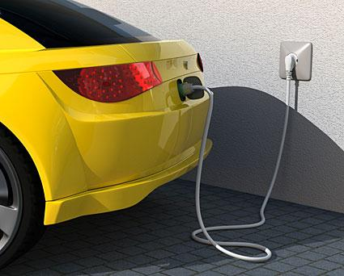
Alternative Fuel Sources

Slide 8
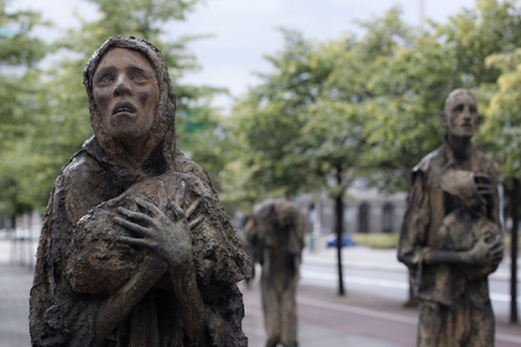
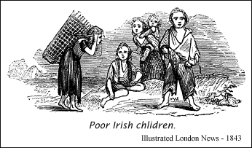
Monoculture
The planting of fields with the same crop year after year.
Increases the ability to mechanize planting, weeding and harvest.
The entire crop is susceptible to a single pest outbreak.

Slide 9
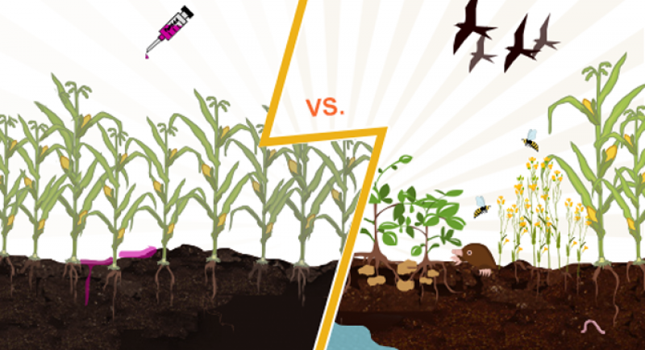
Green Revolution

Slide 10
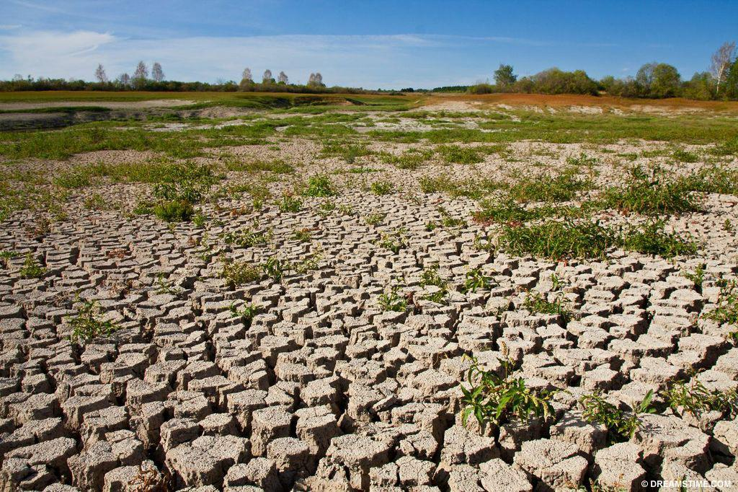
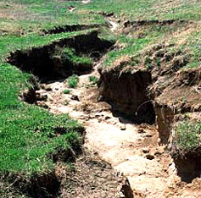
Soil Erosion
Wearing away of surface soil by water and wind.
In some areas, soil erosion has changed good soils into deserts.

Slide 11
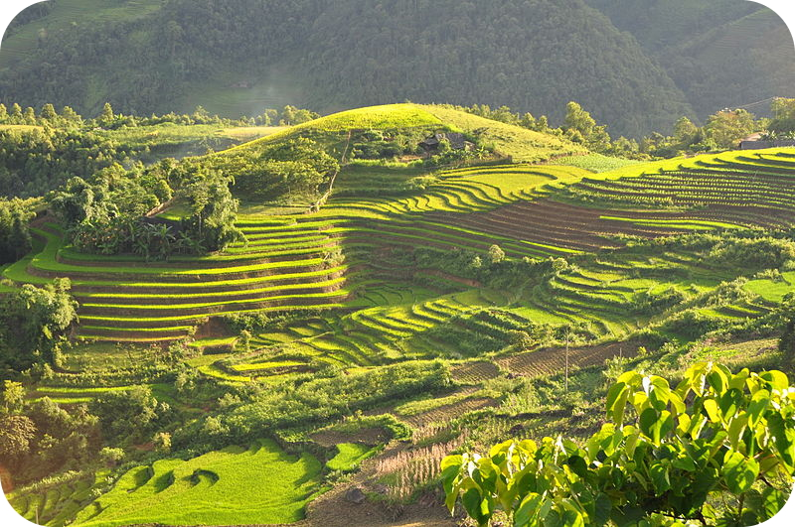
Contour plowing

Slide 12
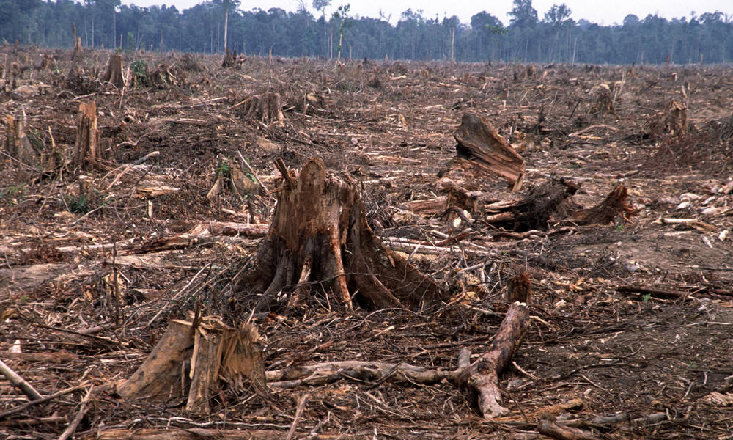
Deforestation
Loss of forests.
Forests supply wood, oxygen, and other resources.

Slide 13
Conservation

Slide 14
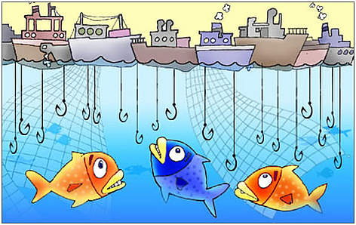
Overfishing
Loss of fish species.
Fish provide food for many countries and are an important part of the oceans ecosystems.

Slide 15
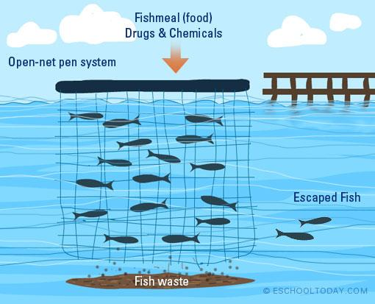
Aquaculture

Slide 16
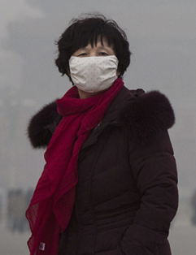
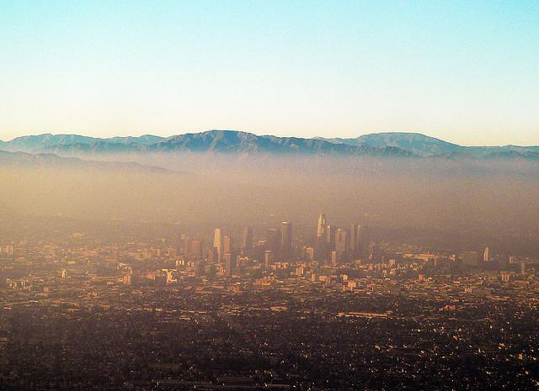
Smog
Mixture of chemicals that forms a gray-brown haze in the air.
Mainly caused by cars and industry.

Slide 17
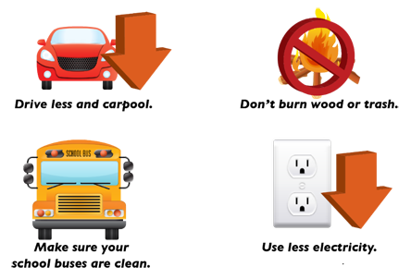
Emission controls

Slide 18
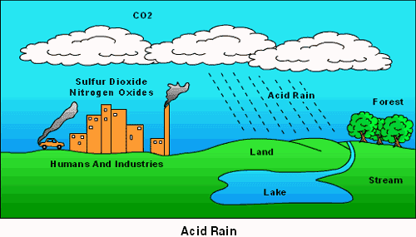
Acid Rain
Some of the chemicals in smog join with water vapor in the air.
Acid rain kills plants and causes other damage.

Slide 19
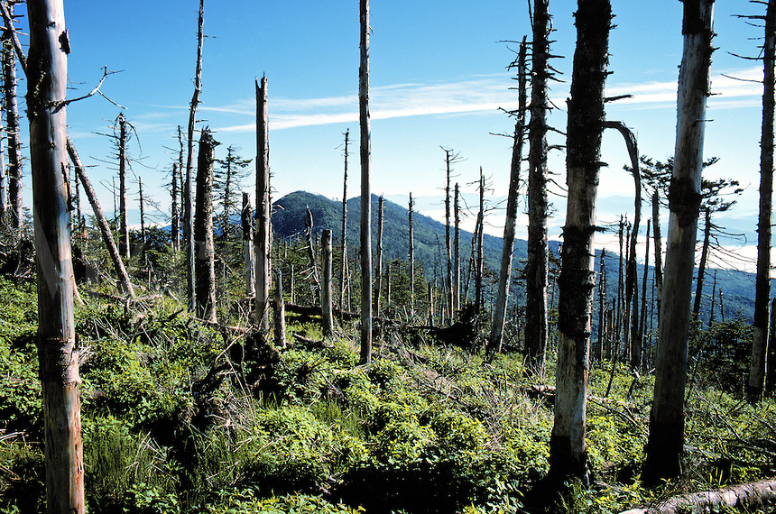
Acid rain in North Carolina

Slide 20
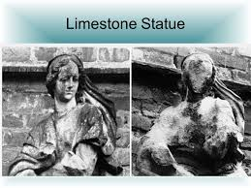
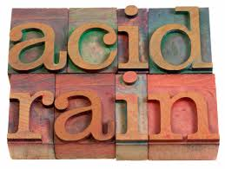
Acid rain and other damage

Slide 21
Emission controls

Slide 22
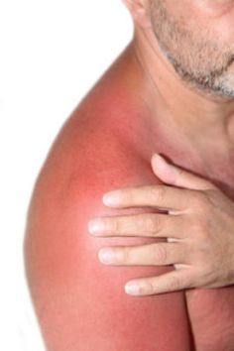
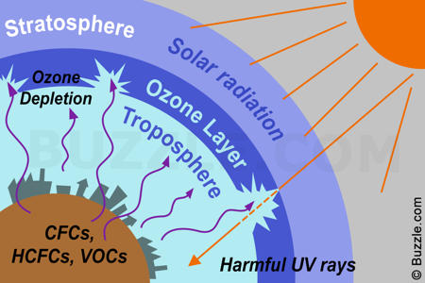
Ozone Depletion
The ozone layer is an area high in the atmosphere that protects the earth from harmful radiation.

Slide 23
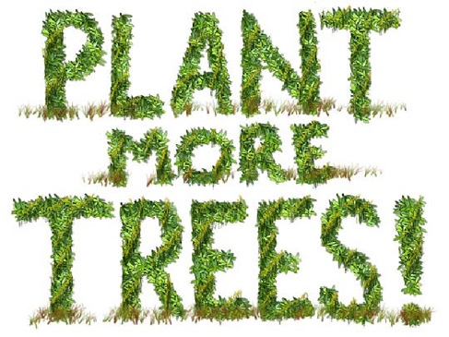
How do I protect the Ozone Layer?
Aerosol sprays
Air Conditioning
Use of refrigeration

Slide 24
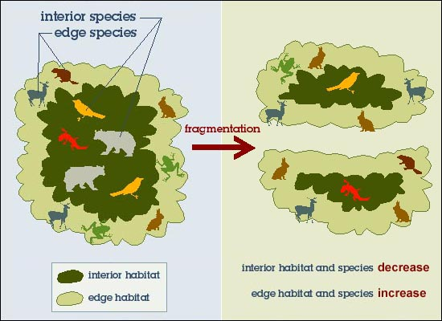
Habitat Fragmentation
Human developments can split habitats
The smaller the pieces of habitat, the less likely its species can survive.

Slide 25
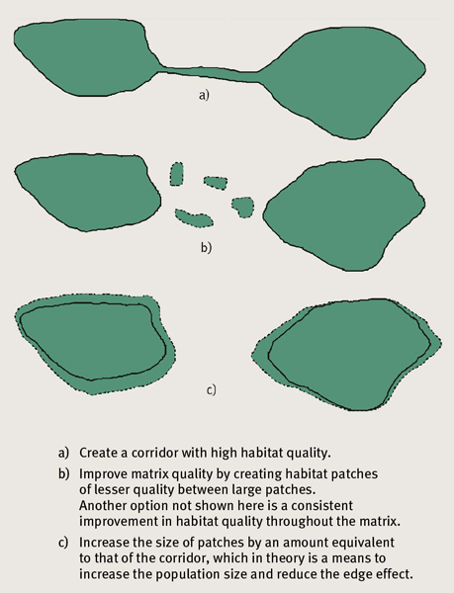
Linking Fragments Reduce Edge Effect

Slide 26
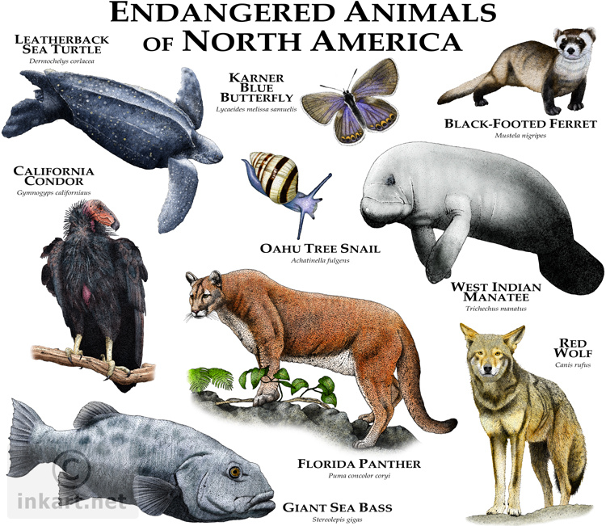
Endangered Species
A species whose population size is declining in a way that places it in danger of extinction.

Slide 27
Conservation Societies & Awareness Campaigns

Slide 28
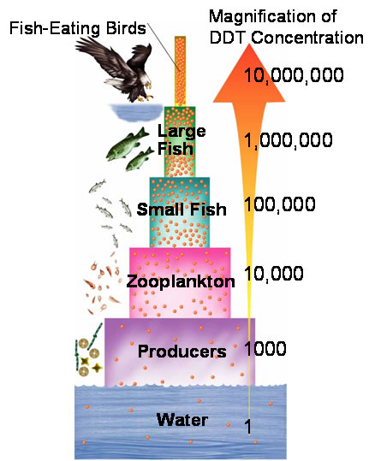
Biological Magnification
Toxic compounds build up in the bodies of organisms.
The concentration of toxic compounds increases the higher the trophic level.
Examples of toxic compounds are lead, mercury and DDT

Slide 29
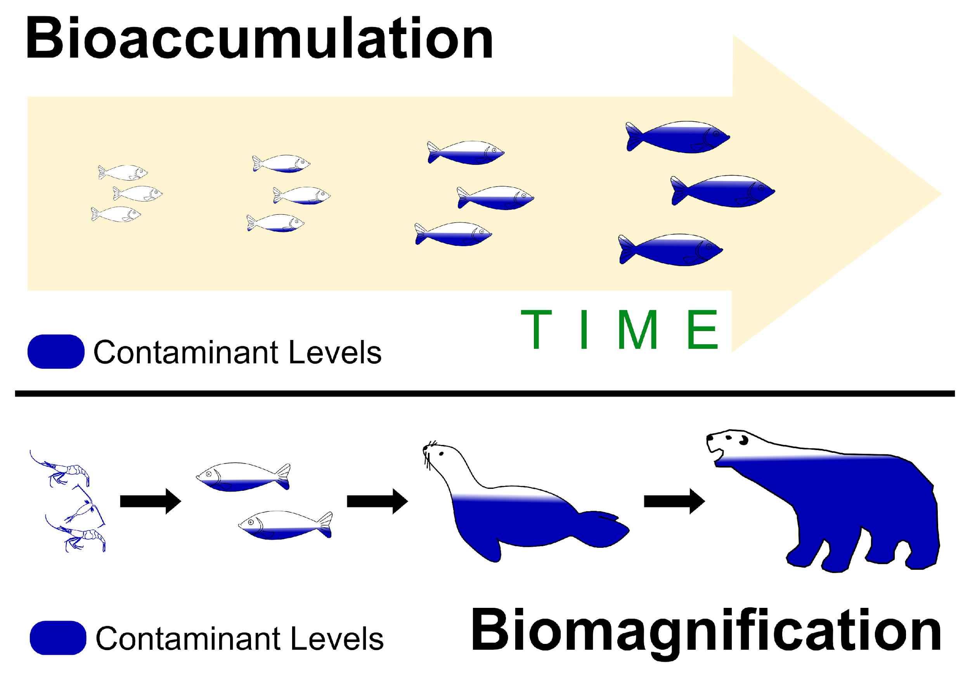
Sickness Levels

Slide 30
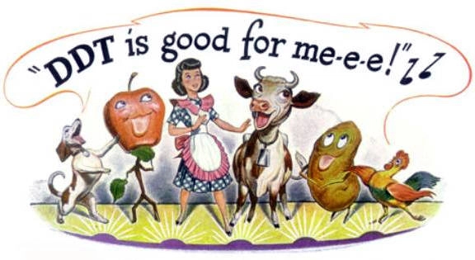
Awareness

Slide 31
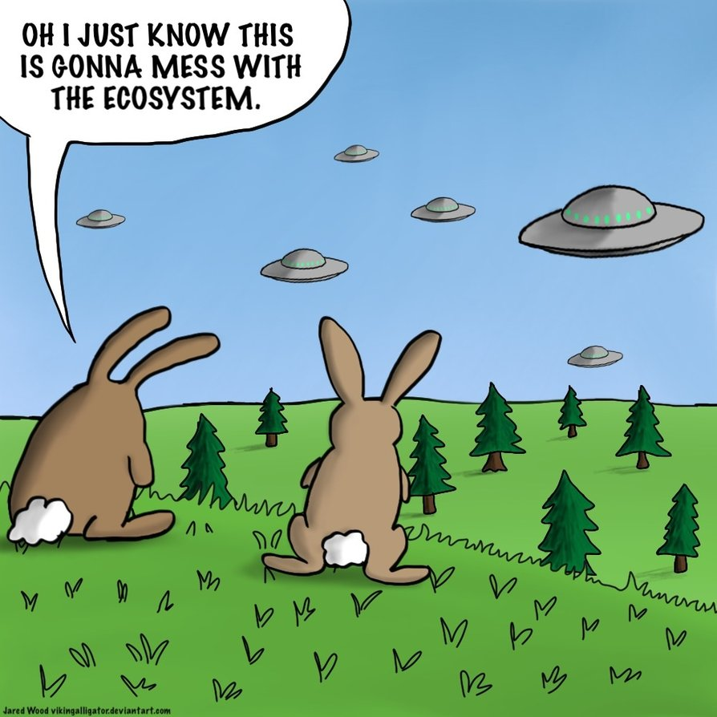
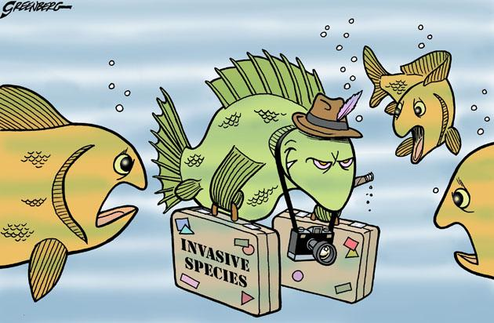
Invasive Species
Plants and animals brought into an area from other places
Invasive species can multiply quickly if their new habitat lacks parasites and predators to control their numbers.

Slide 32
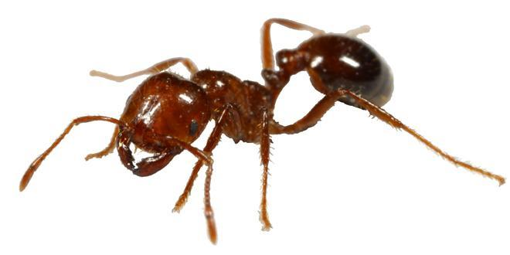
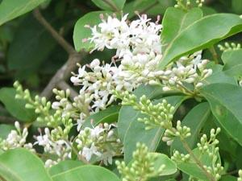
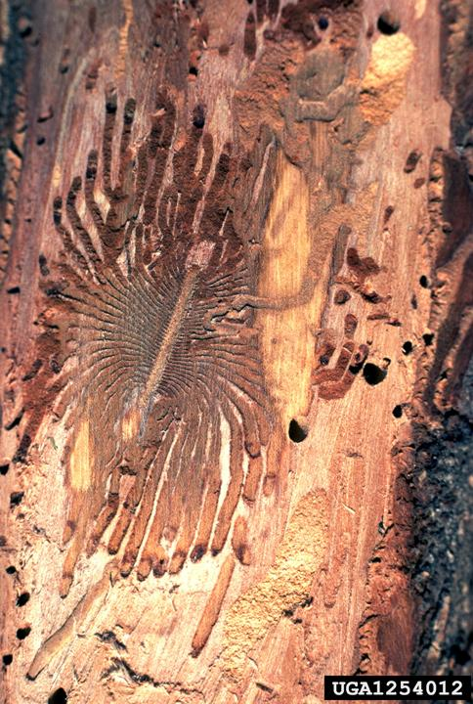
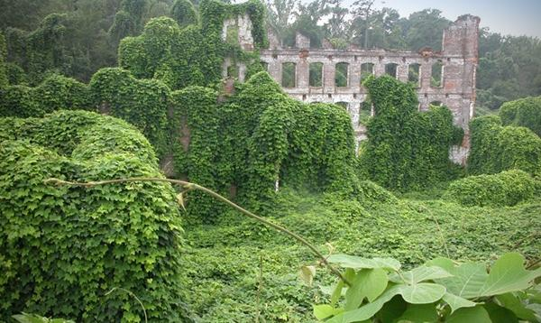
North Carolina Invasive Species

Slide 33
Awareness

Slide 34
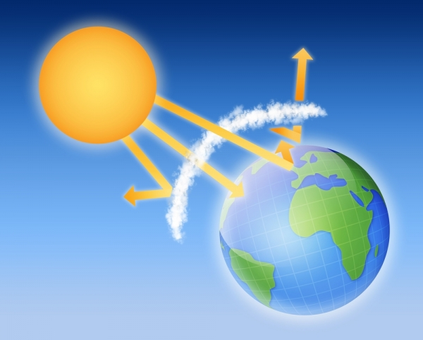
Greenhouse Effect
Greenhouse
Effect

Slide 35
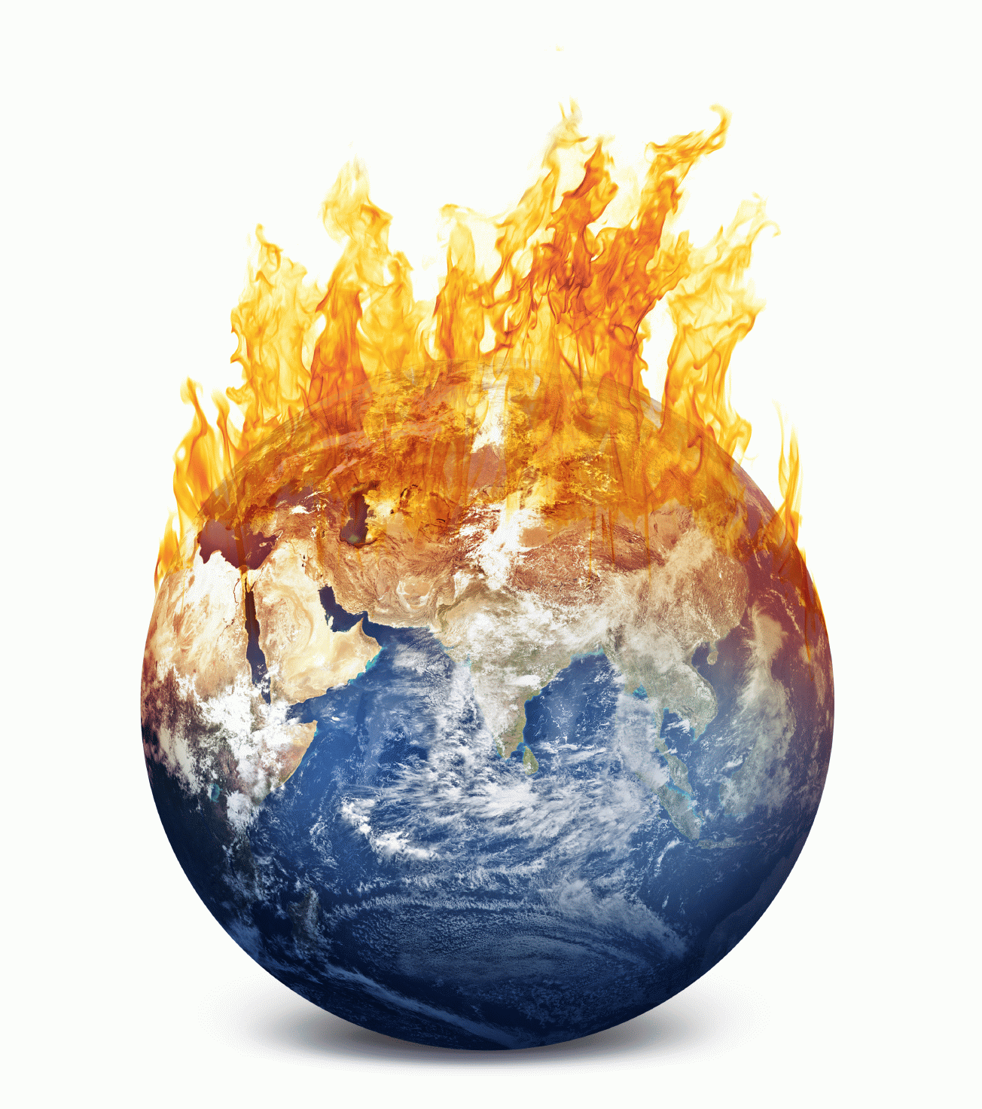
Global Warming
Is an increase in the average temperature of the biosphere.
Global warming is the result of the burning of fossil fuels.
Continued global warming may lead to rising sea levels and coastal flooding.

Slide 36
Conservation

