Slide 1
Evolution of Populations
Guiding Questions:
How can populations evolve to form new species?
How is evolution defined in genetic terms?
What are the sources of genetic variation?
What determines the number of phenotypes for a given trait?
How does natural selection affect single-gene and polygenic traits?
What is genetic drift?
What conditions are required to maintain genetic equilibrium?
What types of isolation lead to the formation of new species?
What is a current hypothesis about Galapagos finch speciation?

Slide 2
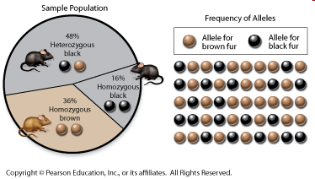
Populations and Gene Pools
Population – a group of individuals of the same species that mate and produce offspring
Gene pool – all genes and the alleles for those genes present in a population
Allele frequency – the number of times an allele occurs in a gene pool compared to the total number of alleles in that pool for the same gene.

Slide 3
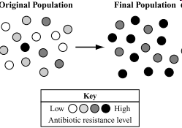
Populations and Gene Pools
Take home message: Evolution, in genetic terms, involves a change in the frequency of alleles in a population over time.
Note: Although natural selection acts on individuals it is the population that evolves, not individuals

Slide 4
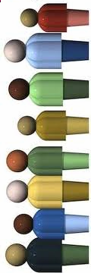
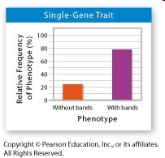
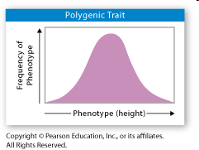
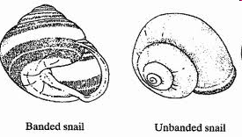
Single-Gene and Polygenic Traits
Single-Gene Trait
Controlled by one gene that has two alleles
Two distinct phenotypes
Ex: bands or no bands on snails
Polygenic Trait
Controlled by more than one gene
Many possible genotypes and phenotypes
Ex: Human Height

Slide 5
Checkpoint Questions

Slide 6
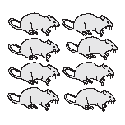
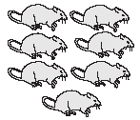
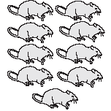
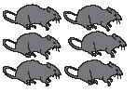
Evolution as Genetic Change in Populations
Natural selection on single gene traits
Evolution does not act on genes. Instead it acts on phenotype frequencies by changing allele frequencies!
Evolution = any change in the relative frequencies of alleles in a population’s gene pool
Initial Population | Generation 10 | Generation 20 | Generation 30
90% | 80% | 70% | 40%
10% | 20% | 30% | 60%

Slide 7
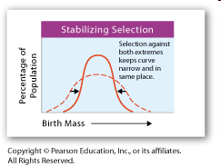
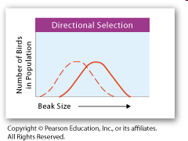
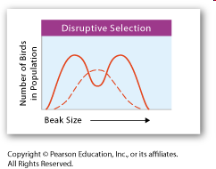
Natural selection on polygenic traits
Natural selection can affect the relative fitness of phenotypes involving polygenic traits in any of 3 ways:
1. Stabilizing Selection -average form of a trait is favored.
* Graph shifts to the middle*
2. Directional Selection -one extreme form of a trait is favored. * Graph shifts to the left or right*
3. Disruptive Selection - either/both extremes of a trait are favored over an average form of a trait.
* graph shifts to the left and right*

Slide 8
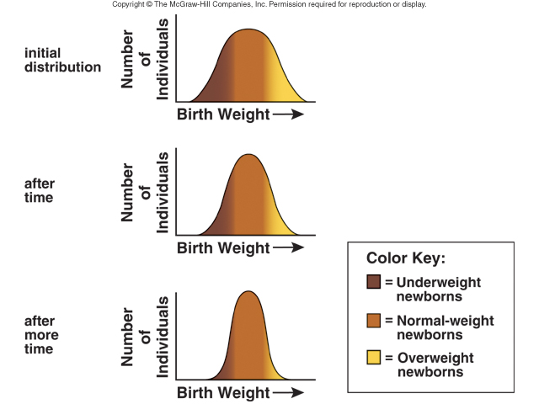
Stabilizing selection

Slide 9
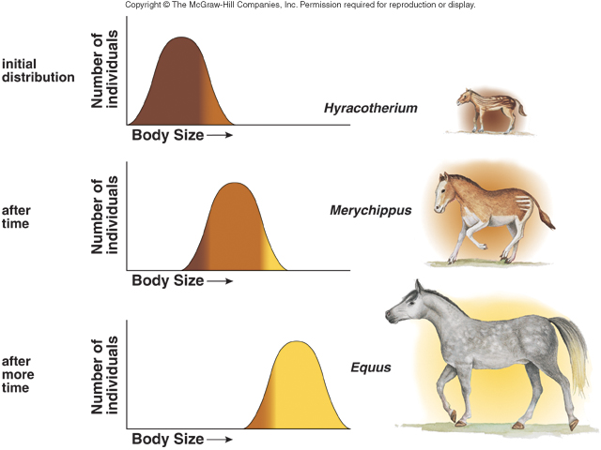
Directional selection

Slide 10
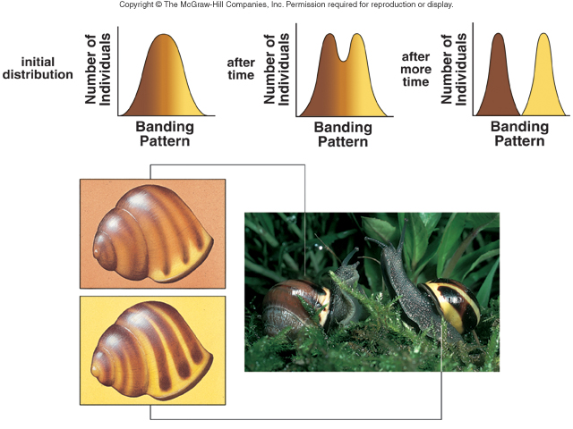
Disruptive selection

Slide 11
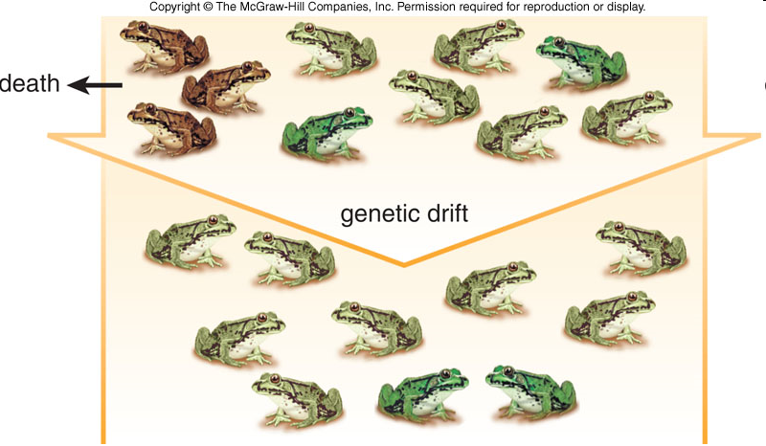
Genetic Drift
Genetic Drift = random change in allele frequency
Acts on small populations
These chance occurrences can cause an allele to become more or less frequent in a population

Slide 12
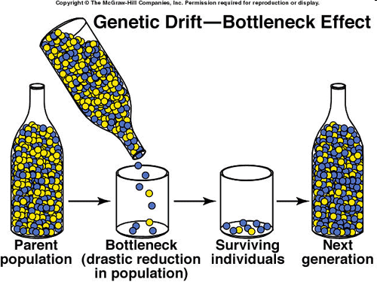
Genetic Bottlenecks
Genetic Bottleneck = a change in allele frequency following a dramatic reduction in the size of a population
Could result from disease, rapid climate or environmental change
Can reduce a population’s genetic diversity

Slide 13
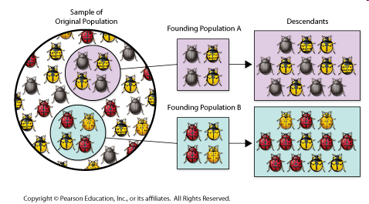
Founder Effect
Founder Effect = when allele frequencies changes as a result of the migration of a small subgroup of a population
Creates a new gene pool that could be different from the parent population

Slide 14
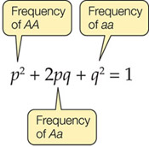
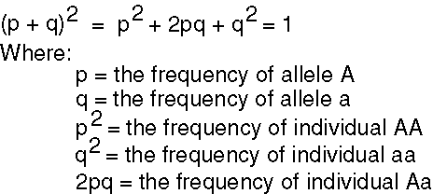
Hardy Weinberg states that for a population to remain in equilibrium, 5 conditions must be met:
large population size
random mating
no immigration or emigration
no mutations
no natural selection
equilibrium = RARE
Evolution vs. Genetic Equilibrium

Slide 15
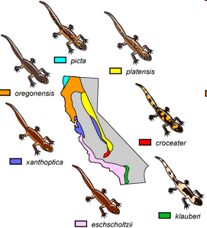
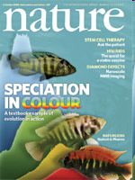
The Process of Speciation
Species - group that can interbreed and produce fertile offspring.
Speciation – the formation of new species, occurs whenever reproductive isolation develops

Slide 16
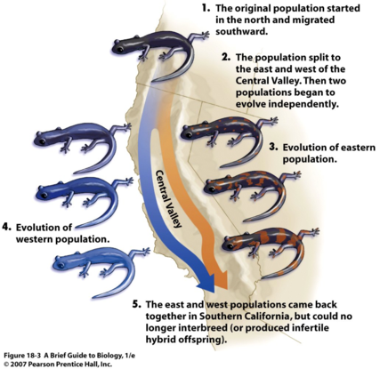
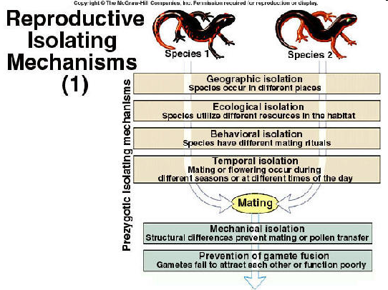
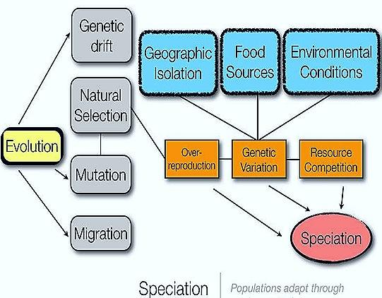
Reproductive isolation develops by:
The Process of Speciation
Behavioral Isolation
Geographic Isolation
Temporal Isolation

Slide 17
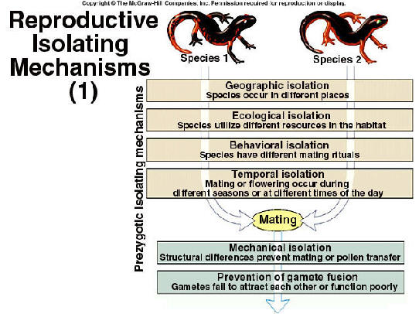
Reproductive isolation develops by:
The Process of Speciation
Behavioral Isolation
Geographic Isolation
Temporal Isolation

Slide 18
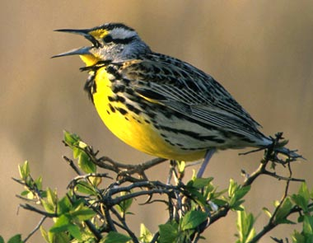
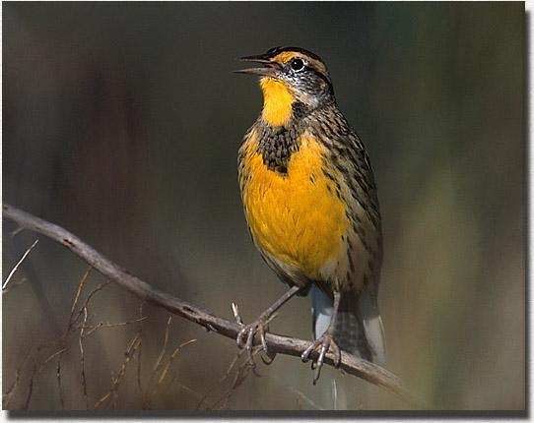
Behavioral Isolation
Two populations are capable of interbreeding
Differences in mating rituals prevent interbreeding
Ex: Similar birds will not interbreed b/c of different mating songs

Slide 19
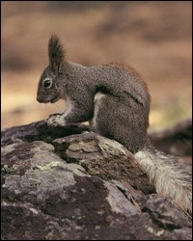
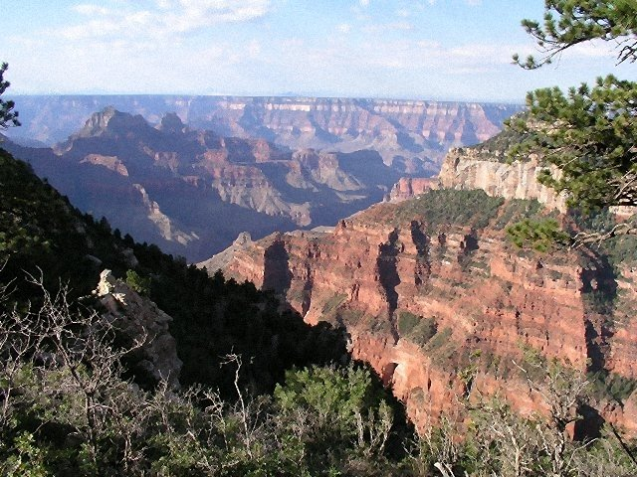
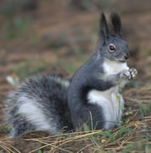
Geographic Isolation
2 populations are physically separated by barriers
Rivers
Mountains
Bodies of water

Slide 20
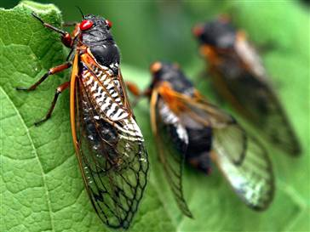
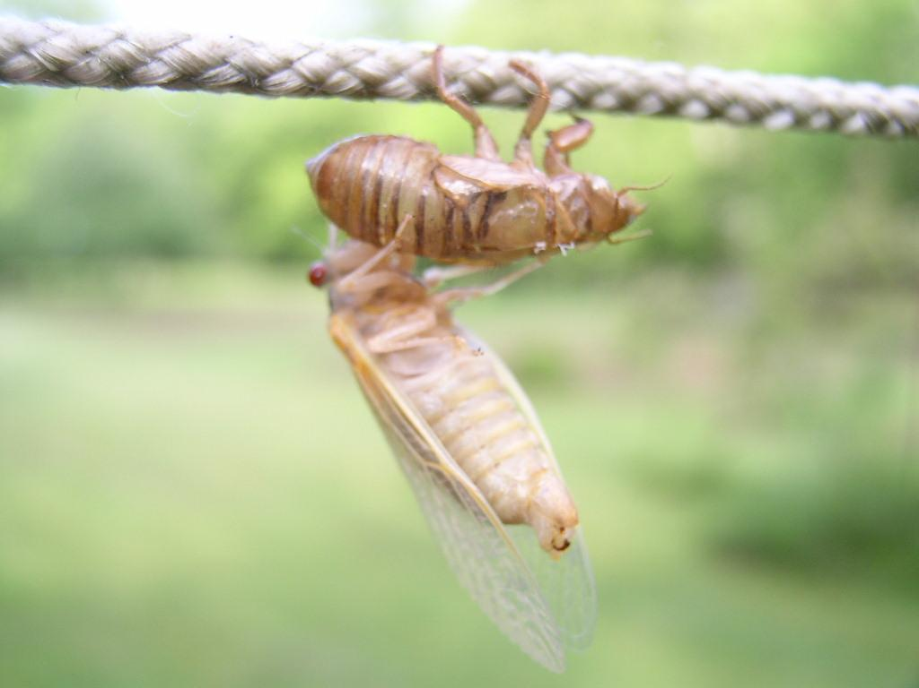
Temporal Isolation
Two or more species reproduce at different times
Ex: One form of cicada emerges every 17 years, the other emerges every 13 years.

Slide 21
State Standards
EVOLUTION
• Mechanisms
• Natural selection
• Mutation
• Genetic drift
• Gene flow (immigration, emigration)
• Sexual selection
• History of life on Earth
• Diversity of Life
• Speciation and biological classification based on molecular evidence
• Variation of org

