Slide 1
2.5 Enzymes
Notes:
How does a Venus flytrap digest a bug? Thru the action of proteins called enzymes. Needed to start and run chemical reactions in living things. Without enzyme, the Venus fly trap could not break down food and neither could you.

Slide 2
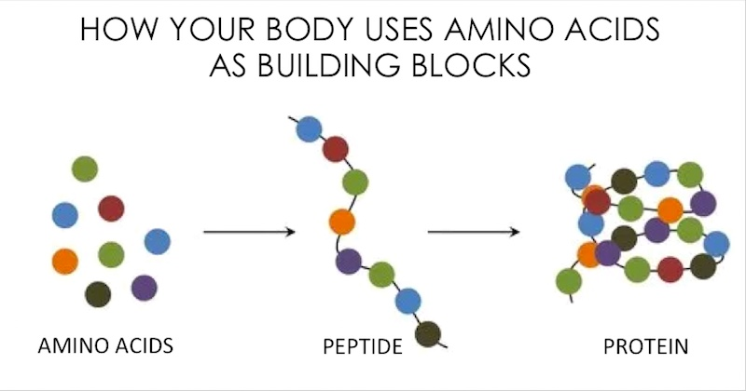
Enzyme Composition
All enzymes are made of protein.
Remember that proteins are made of amino acids.

Slide 3
Chemical reactions need energy to get started.
Ex: A fire needs a match to get it started.

Slide 4
Activation energy: the energy needed to START a chemical reaction.
ACTIVATION ENERGY
REACTANTS
PRODUCTS

Slide 5
Activation energy is like pushing a rock up a hill.

Slide 6
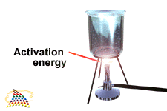
Activation energy for a chemical reaction to start often comes from applying heat, but…

Slide 7
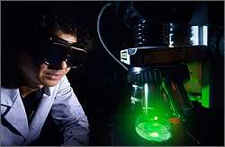
…the chemical reaction may still occur very slowly.
To speed things up, a catalyst can be added.

Slide 8
An enzyme is a type of catalyst, which does two things:
reduces the energy needed for a chemical reaction and
increases the rate of the reaction (speeds it up).

Slide 9
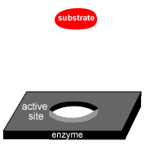
The specific reactants the enzyme works on are called substrates and bind to them at a place called the active site.

Slide 10
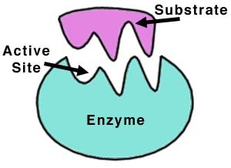
Substrates bind to enzymes at specific places called active sites.

Slide 11
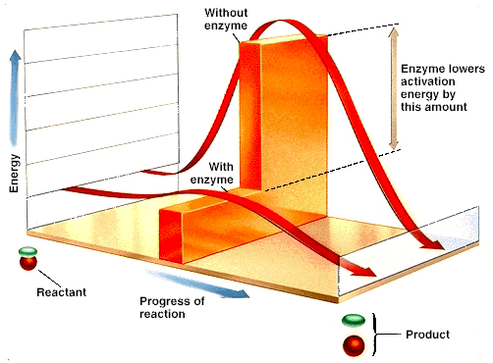
An exothermic chemical reaction releases energy in the form of heat.
An endothermic reaction absorbs energy in the form of heat.
Exo= outside
Endo= inside
Therm= temperature; heat

Slide 12
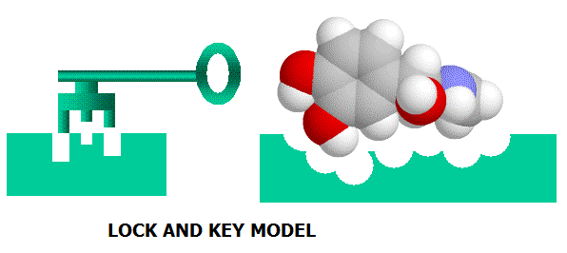
Just like a key can only open a specific lock, and enzyme can only work on a specific substrate. Form = Function

Slide 13
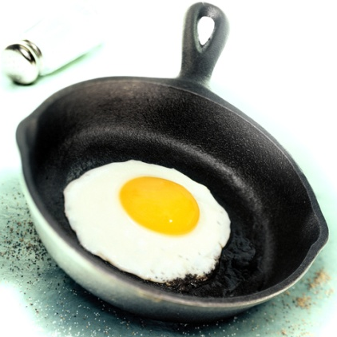
We know when talking about proteins (and enzymes since they are made of proteins) that form=function.
The process of changing/destroying the shape of a protein/enzyme is called denaturing.
Two factors that cause this
are pH and temperature

Slide 14
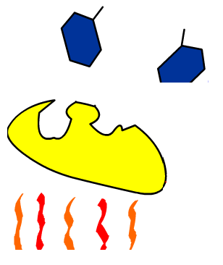
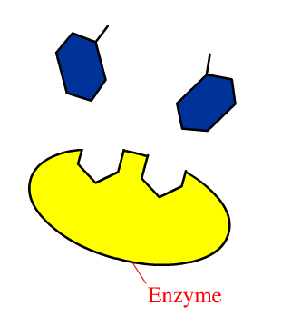
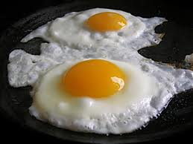
Denaturing changes the shape of the active site so the enzyme cannot bind to the substrate

Slide 15
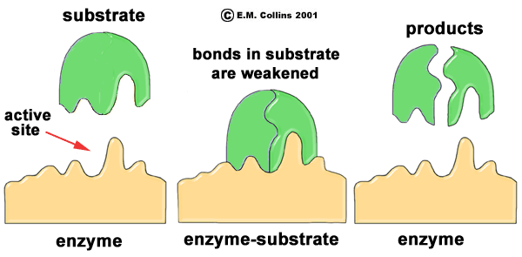
Substrates bind to the
enzyme’s active site.
1

Slide 16
2 The enzyme weakens
bonds in the substrate.

Slide 17
3
A new product is formed. The enzyme is free to catalyze other reactions.

Slide 18
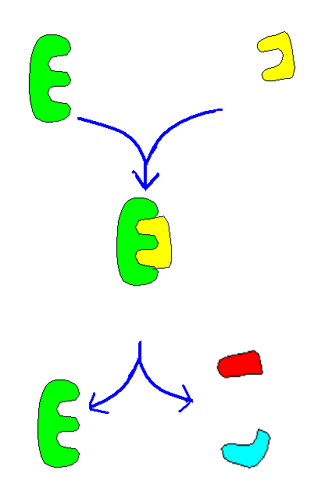
ENZYME
SUBSTRATE
ENZYME-SUBSTRATE
COMPLEX
ENZYME Unchanged
& Reusable
PRODUCTS

Slide 20
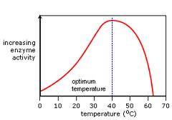
Effect of temperature on enzyme activity

Slide 21
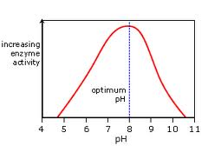
Effect of pH on enzyme activity

Slide 22
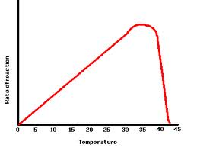

Slide 23
